Slide 1
Listening to Pauline Shame


Slide 2
Table of Contents
Introduction Definitions
OT Background New Testament
Contemporary Contribution Contemporary Challenges Conclusion


Slide 3
Introduction


Slide 4
Fractured Understanding of Shame


Slide 5
Negative stance towards shame


Slide 6
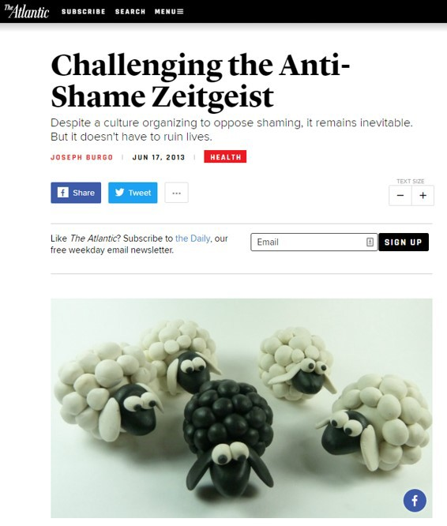
Anti-Shame Zeitgeist


Slide 7
Brené Brown


Slide 8
Oprah
Dr. Brené Brown: "Shame Is Lethal" | SuperSoul Sunday | Oprah Winfrey Network


Slide 9
TED Talk: Listening to Shame
Listening to shame | Brené Brown


Slide 10
I Thought It was Just Me
"It didn't take very long for me to reach the conclusion that there is nothing positive about shame. In any form, in any context and through any delivery system, shame is destructive. The idea that there are two types, healthy shame and toxic shame, did not bear out in any of my research."


Slide 11
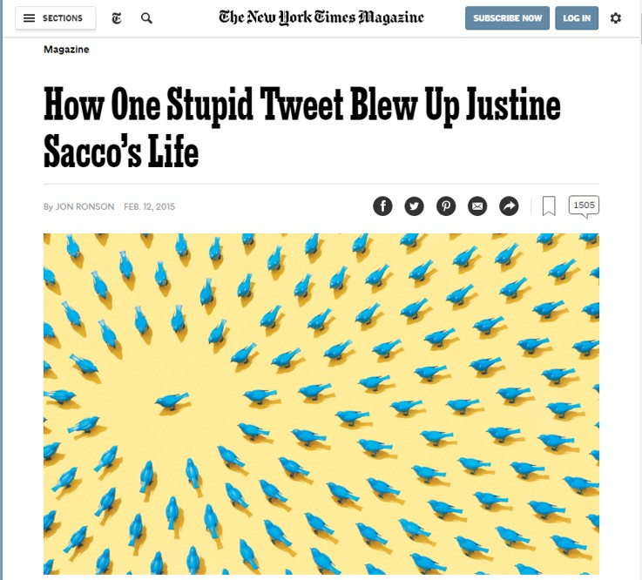
Social Media


Slide 12
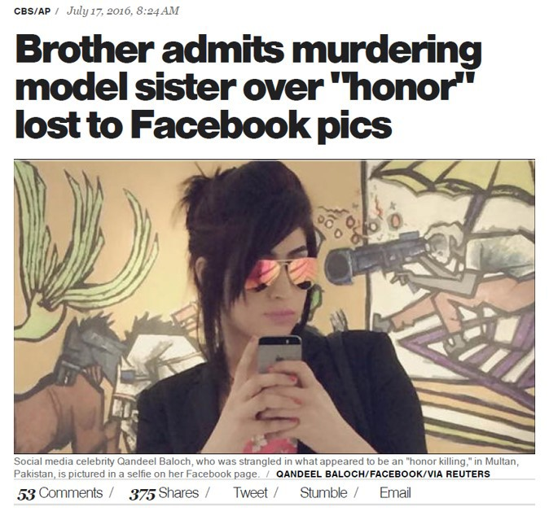
Honor killings


Slide 13


Slide 14
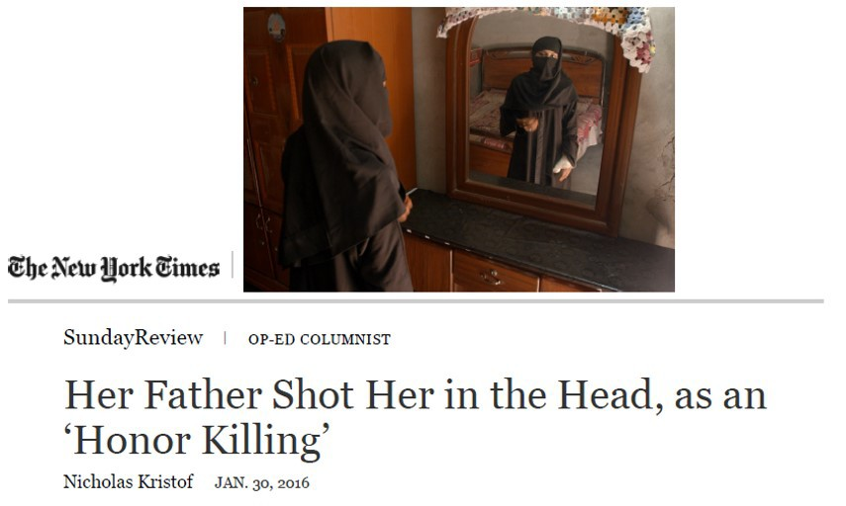

12 . 2

Slide 15
Use of shaming


Slide 16
Governments Use Shame Punitively


Slide 17
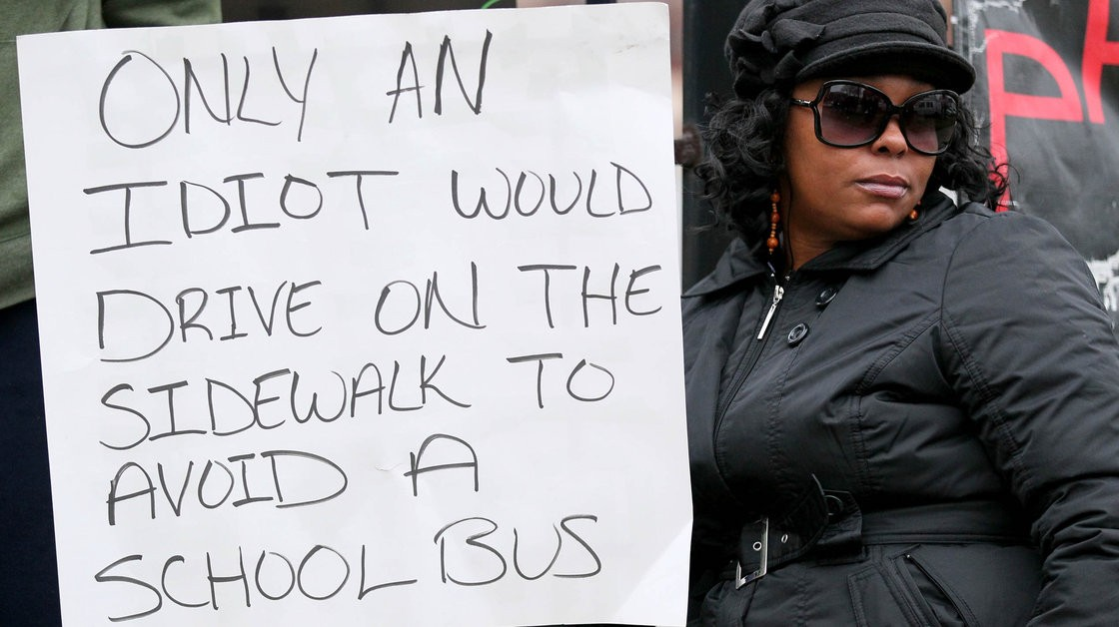


Slide 18
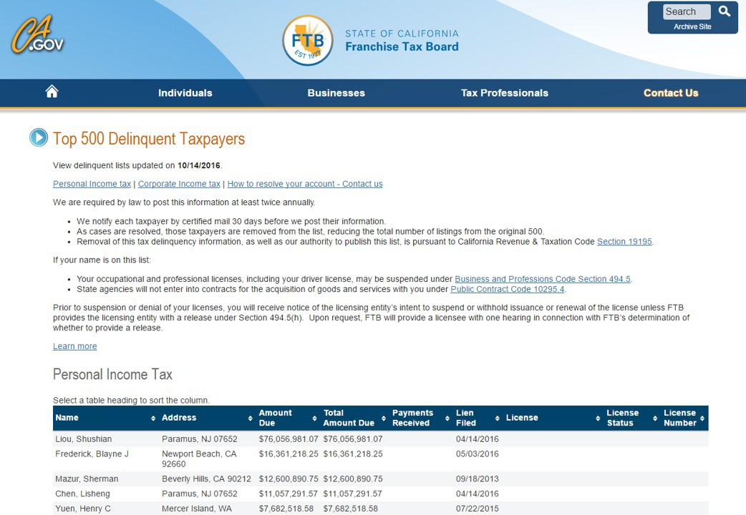


Slide 19
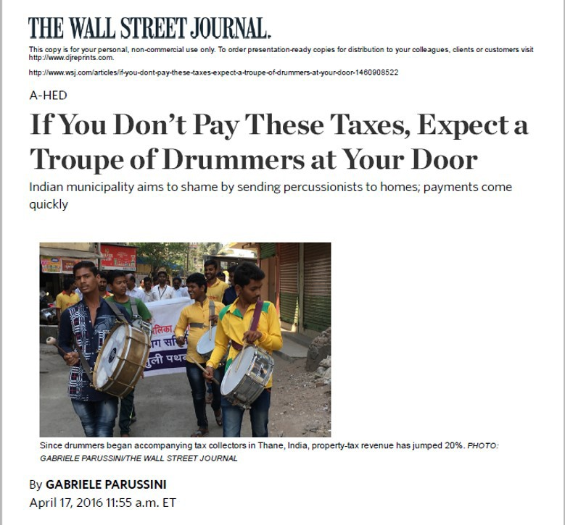


Slide 20
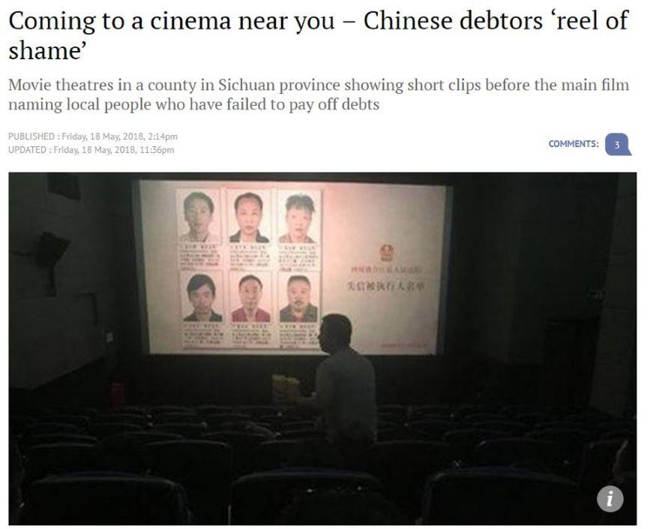


Slide 21
Churches using Shaming


Slide 22
Summary


Slide 23
Issues
Attitude towards shame
We have a deep aversion to shame.
Yet, we recognize that shame is fundamental to moral character … we don't want to be shameless.
What about shaming?
Is it appropriate to use shame as a means to reform behavior?


Slide 24
Brief biblical data
Paul chastises those who are shameless and indulge in every sordid impurity
Eph 4:19 Having lost all sensitivity, they have given themselves over to sensuality so as to indulge in every kind of impurity….
Paul also shames and rebukes his readers
"I say this to your shame" (1 Cor 6:5; 15:34)
"You foolish Galatians! … Are you so foolish?" (Gal 3:1, 3)


Slide 25
A Way Forward
Impossible to eliminate shame
Absence of shame != self-esteem, but shamelessness
Better to rehabilitate shame, understanding how shame should function according to God's intention.


Slide 26
Definitions


Slide 27
Conceptual Clarifications
"We don't need more shame" "You have no shame"


Slide 28
2 major categories of shame
Objective shame (e.g., I am disgraced) [Shame as a social value] Subjective shame (e.g., I am ashamed) [Shame as an emotion]


Slide 29
Cause of shame
Ascribed shame
Shame not because of what I've done Attained shame
Shame because of what I've done


Slide 30
Shame as an emotion
Shame is the painful emotion that arises from an awareness that one has fallen short of some standard, ideal, or goal.


Slide 31
Shame and Humiliation
Shame
Self reflecting on self Self has fallen short
Humiliation
Self reflecting on what others are doing to you Self is not blameworthy


Slide 32
Shame and Guilt
Distinction #1: Self or Behavior Distinction #2: Public or Private Distinction #3: Non-moral or Moral Assessment


Slide 33
 | Modern Shame | Modern Guilt
Type of eliciting event | Moral and non-moral | Moral
Focus of evaluation | Self | Behavior
Locus of evaluation | Public | Private
Degree of distress | Generally more painful | Generally less painful
Phenomenological experience | Shrinking, feeling small, feeling worthless, powerless, anger | Tense, remorse, regret
Concern vis-à-vis the "other" | Concern with others' evaluation of self (self-oriented distress) | Concern with one's effect on others (other-oriented empathy)
Motivational features | Desire to hide, escape, deny, strike back, or blame others | Desire to confess, repent, and repair

30 . 2

Slide 34
OT Background
In you, LORD my God, I put my trust.
I trust in you;
do not let me be put to shame,
nor let my enemies triumph over me.
No one who hopes in you will ever be put to shame,
but shame will come on those
who are treacherous without cause. (Ps 25:1-3)

31 . 1

Slide 35
Created for glory; mired in shame (Gen 1-3)

32 . 1

Slide 36
Shame is a relational concept and is generated by a fractured relationship. Shame is a function of sin.
Shame is the necessary condition of sinful humanity. Creation shares in the shame of humanity.
Only God is adequate to redress humanity's shame.

32 . 2

Slide 37
Shame and the Deuteronomic covenant
Blessings of the covenant: Honor Curses of the covenant: Shame Criteria of covenantal faithfulness
Failure to revere the glorious and awesome name of the Lord // failure to obey all the words of the covenant (Deut 28:58).
Lex talionis:
"Those who honor me I will honor, and those who despise me shall be treated with contempt." (1 Sam 2:30)

33 . 1

Slide 38
Shame, judgment, and redemption (Prophetic literature)
Shame is frequently tied to sin, judgment, repentance, and salvation Israel's sin brings shame upon themselves
In their idolatry, they become what they worship
They no longer reflect the glory of God, but the shame of idols.

34 . 1

Slide 39
Shame is not the last word if objective shame is internalized Disobedience of covenantal obligations → Covenantal curses and shame before other nations → Internalized shame concerning one's sin → Repentance → Restoration → Objective Honor for Israel → Glory to God.
But, Israel remains hardened.
Jerusalem's exile → Shame on God
God feels sorry for his name (Ezek 36:21) He promises the New Covenant

34 . 2

Slide 40
New Testament

35 . 1

Slide 41
Shame and the gospel in Romans


Slide 42
What is sin?
Rom 1:21 For although they knew God, they neither glorified him as God nor gave thanks to him, but their thinking became futile and their foolish hearts were darkened. 22 Although they claimed to be wise, they became fools 23 and exchanged the glory of the immortal God for images made to look like a mortal human being and birds and animals and reptiles.
…. 25 They exchanged the truth about God for a lie, and worshiped and served created things rather than the Creator—who is forever praised.


Slide 43
What is the consequence of sin?
1:24 Therefore God gave them over in the sinful desires of their hearts to sexual impurity for the degrading (ἀτιμάζω) of their bodies with one another. 25 They exchanged the truth about God for a lie, and worshiped and served created things rather than the Creator—who is forever praised. Amen.
26 Because of this, God gave them over to shameful (ἀτιμία) lusts. Even their women exchanged natural sexual relations for unnatural ones. 27 In the same way the men also abandoned natural relations with women and were inflamed with lust for one another. Men committed shameful (ἀσχημοσύνη) acts with other men, and received in themselves the due penalty for their error.
28 Furthermore, just as they did not think it worthwhile to retain the knowledge of God, so God gave them over to a depraved (ἀδόκιμος) mind, so that they do what ought not to be done.


Slide 44
What is the nature of faith?
4:18 Against all hope, Abraham in hope believed and so became the father of many nations, just as it had been said to him, "So shall your offspring be."
19 Without weakening in his faith, he faced the fact that his body was as good as dead—since he was about a hundred years old—and that Sarah's womb was also dead. 20 Yet he did not waver through unbelief regarding the promise of God, but was strengthened in his faith and gave glory to God, 21 being fully persuaded that God had power to do what he had promised. 22 This is why "it was credited to him as righteousness."


Slide 45
What is the consequence of faith?
5:1 Therefore, since we have been justified through faith, we have peace with God through our Lord Jesus Christ, 2 through whom we have gained access by faith into this grace in which we now stand. And we boast in the hope of the glory of God. 3 Not only so, but we also glory in our sufferings, because we know that suffering produces perseverance; 4 perseverance, character; and character, hope.
5 And hope does not put us to shame (ἡ δὲ ἐλπὶς οὐ καταισχύνει), because God's love has been poured out into our hearts through the Holy Spirit, who has been given to us.
10:11 "Everyone who trusts in him will not be put to shame" at the final judgment.


Slide 46
Shame and the Church
Honor and shame is now determined by the cross
Church is to live according to this new value system. Specifically, … Not ashamed of the crucified Messiah
Not ashamed of the Gospel of a crucified Messiah Only basis of honor is Christ
Live in a manner worthy of the Gospel (Phil 1:27)
Do not shrink back and conform to society's pressure shame of suffering precedes glory
do not retaliate, but do good (heap burning coals; Rom 12:20)


Slide 47
Shaming Discipline


Slide 48
1 Cor 4:14
4:14 "I am writing this not to shame you, but to admonish you"
4:8-13 Already you have all you want! Already you have become rich! You have begun to reign—and that without us! How I wish that you really had begun to reign so that we also might reign with you! … 10 We are fools for Christ, but you are so wise in Christ! We are weak, but you are strong! You are honored, we are dishonored!


Slide 49
I am writing this not (οὐ) to shame you, but (ἀλλά) to admonish (νουθετέω) you as my beloved children.
Mark 9:37 Whoever welcomes me does not (οὐ) welcome me, but (ἀλλά) the one who sent me.
John 12:44 Whoever believes in me does not (οὐ) believe in me only, but (ἀλλά) in the one who sent me.
Acts 5:4 "You have not (οὐκ) lied just to human beings, but (ἀλλά) to God"
not (οὐ) X, but (ἀλλά) Y ⇒ not primarily X, but Y


Slide 50
What is the goal of this admonition?
νουθετέω ("to admonish") derives from νοῦν τίθημι ("to impart a mind or understanding" or "to put in the right mind."
What does "mind" (νοῦς) mean? Earlier occurrences of "mind" (νοῦς)
1:10 "you might be united in the same mind (νοῦς)
2:16 Believers have the "mind of Christ" (νοῦς Χριστοῦ)
4:14 "I am writing this not to shame you, but to admonish (νουθετέω) you.
Summary


Slide 51
2 Thess 3
14 Take special note of anyone who does not obey our instruction in this letter. Do not associate with them, in order that they may feel ashamed. 15 Yet do not regard them as an enemy, but warn them as you would a fellow believer.


Slide 52
Developing a sense of shame


Slide 53
Phil 1:27
Only, live your life in a manner worthy of the gospel of Christ.
2 main courts of opinions human | divine


Slide 54
Constructing an alternate court of opinion
Caesar | Divine Judge
Community of faith—the visible court of opinion Path to honor
Reinterpretation of honor and shame Promise of greater honor


Slide 55
Contemporary Contribution


Slide 56
Braithwaite, Reintegrative Shaming Theory


Slide 57
Reintegrative Shaming Theory
"The theory in this book suggests that the key to crime control is cultural commitments to shaming in ways that I call reintegrative.
Societies with low crime rates are those that shame potently and judiciously; individuals who resort to crime are those insulated from shame over their wrongdoing. However, shame can be applied injudiciously and counterproductively; the theory seeks to specify the types of shaming which cause rather than prevent crime."


Slide 58
Disintegrative and Reintegrative Shaming
Disintegrative shaming Harmful Stigmatizing
Deviant label applied to the offender without thought of de-labelling


Slide 59
Reintegrative shaming Helpful
Expression of disapproval is limited in time
Act of shaming is followed by efforts to reintegrate offender back into the community
Deviant label applied to the act, not the person
Person is seen as a good person who has done a bad act

51 . 2

Slide 60
Social Conditions Conducive to RS
Communitarianism Interdependency

52 . 1

Slide 61
Shame in the Chinese Culture


Slide 62
Gate to Chinatown in Chicago/Boston
Shame/sense of shame
Integrity Justice Propriety


Slide 63
Shame/sense of shame
Integrity Justice Propriety

54 . 2

Slide 64
Amy Chua, Battle Hymn of the Tiger Mother
"The solution to substandard performance is always to excoriate, punish, and shame the child. The Chinese parent believes that their child will be strong enough to take the shaming and to improve from it."

55 . 1

Slide 65
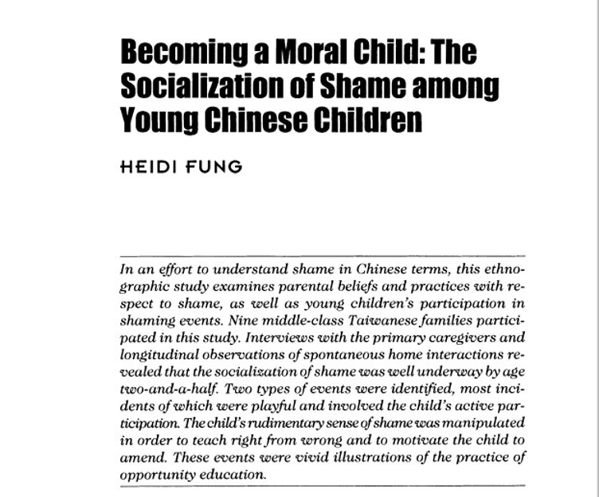
Heidi Fung


Slide 66
Hypercognition of shame in Asian families
Use of shame for moral formation, beginning at age 2 ½. Comparison to Euro-American mothers
10% of Euro-American mothers believe that their children (2 ½ - 3 yrs old) understood "ashamed"
95% of Chinese mothers believe that their children in the same age group understand "shame/shyness (羞)"
Probably more shame words in the Chinese language than in any other language
113 prototypical terms divided into 6 different clusters


Slide 67
Contemporary Challenges


Slide 68
Guilt, not shame, is the preferred moral emotion


Slide 69
Complexity of Pauline shame
 | Modern Shame | Modern Guilt
Type of eliciting event | Moral and non-moral | Moral
Focus of evaluation | Self | Behavior
Locus of evaluation | Public | Private
Degree of distress | Generally more painful | Generally less painful
Phenomenological experience | Shrinking, feeling small, feeling worthless, powerless, anger | Tense, remorse, regret
Concern vis-à-vis the "other" | Concern with others' evaluation of self (self-oriented distress) | Concern with one's effect on others (other-oriented empathy)
Motivational features | Desire to hide, escape, deny, strike back, or blame others | Desire to confess, repent, and repair


Slide 70
 | Modern Shame | Modern Guilt | Pauline Shame
Type of eliciting event | Moral and non-moral | Moral | Contrary to the gospel
Focus of evaluation | Self | Behavior | Global self and specific behavior
Locus of evaluation | Public | Private | Before God
Degree of distress | Generally more painful | Generally less painful | Varied
Phenomenological experience | Shrinking, feeling small, feeling worthless, powerless, anger | Tense, remorse, regret | Contrition
Concern vis-à-vis the "other" | Concern with others' evaluation of self (self- oriented distress) | Concern with one's effect on others (other- oriented empathy) | Concern with God's evaluation of self and with one's effect on God and others
Motivational features  | Desire to hide, escape, deny, strike back, or | Desire to confess, repent, and repair | Desire to confess, repent, and walk in the Spirit 60 .
2

Slide 71
Pauline shame is not heteronomous, but theonomous
Guilt: autonomous (dependent on the moral judgment of the self) Shame: heteronomous (dependent on the moral judgment of others) Pauline shame: theonomous (dependent on the moral judgment of God)


Slide 72
Guilt is inadequate
Fails to underscore the gravity of sin Guilt cannot understand itself
Guilt treats only the symptoms


Slide 73
Shame is toxic and destructive
Perception #1: Shame destroys one's self-esteem Perception #2: Acts of shaming are destructive


Slide 74
Conclusion
Impossible to expunge shame Instead, we should rehabilitate it




