Slide 1
The Power of Christian Identity in Conflict
CPR

Slide 2
Overview
Life is all about relationship
God has given us royal titles
Live out your royal titles through relational wisdom
Grow in relational wisdom and peacemaking
Outline with live links at rw360.org/xenos23

Slide 3
- A -
Life Is All About Relationship

Slide 4
Reconciling Two Stubborn Scientists

Slide 5
Life is all about relationships

Slide 6
Relationships are fueled and moved by emotions!

Slide 7
Emotions also overthrow us

Slide 8
Relational Wisdom: God’s 3D Design for Relationships
Aware
Engaging
“What do I know?”
“What will I do?”
God
God
Aware
Engaging
Other
Self
Engaging
Aware
Other
Self
Aware
Engaging

Slide 9
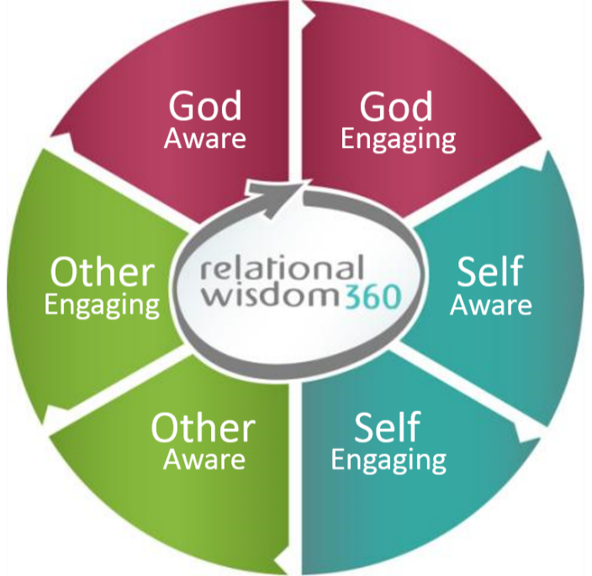
Living Out the Two Great Commandments
“You shall love the Lord your God with all your heart …
and love your neighbor
as yourself”
Matthew 22:37-39

Slide 10
Living Out the Two Great Commandments
Relational wisdom may also be defined as your ability to discern emotions, interests and abilities in yourself and others, to interpret this information in the light of God’s Word, and to use these insights to manage your responses and relationships successfully.

Slide 11
RW Is Taught in “360’s” Throughout Scripture
“And do not grieve the Holy Spirit of God, by whom you were sealed for the day of redemption.
Let all bitterness and wrath and anger and clamor and slander be put away from you, along with all malice.
Be kind to one another, tender-hearted, forgiving one another,
as God in Christ forgave you.”
Ephesians 4:30-32

Slide 12
RW is an outpouring of the gospel

Slide 13
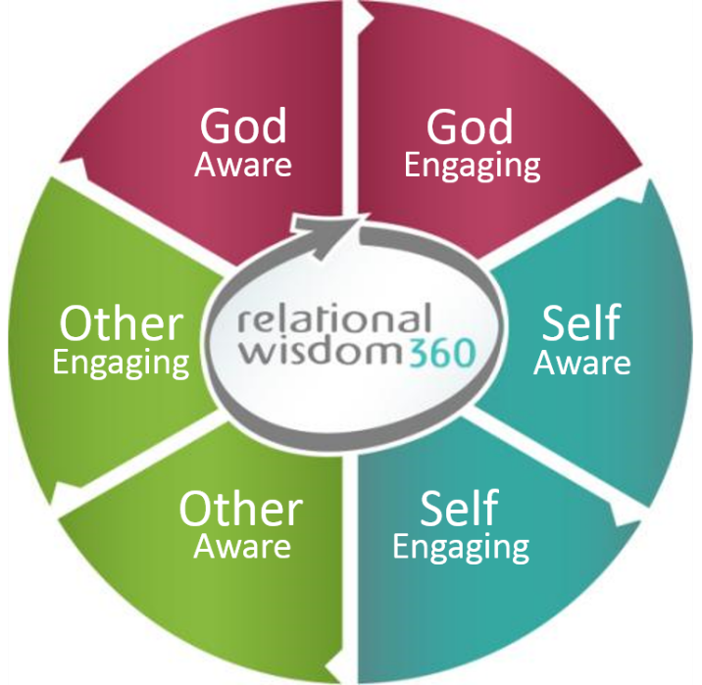
Four Simple Acrostics
Make it Easy to Improve RW
SOG
GPS
SERVE
READ

Slide 14
To Be Relationally Wise in all Situations
Practice
the SOG Plan
Self-aware
Other-aware
God-aware

Slide 15
To Become More
God-Aware and God-Engaging
Follow a
trustworthy GPS
Glorify God
Pursue God
Serve God

Slide 16
To Become More
Self-Aware and Self-Engaging
READ Yourself Accurately
Recognize
Evaluate
Anticipate
Direct
rw360.org/hijacked

Slide 17
To Become More
Other-Aware and Other-Engaging
SERVE Others
Smile
Explore and Empathize
Reconcile
Value
Encourage

Slide 18
- B -
God Has Given Use an Array of
Royal Titles

Slide 19
“You are a chosen race, a royal priesthood, a holy nation” (1 Peter 2:9).

Slide 20
“The hour is coming, and is now here, when the true WORSHIPPERS will worship the Father in spirit and truth, for the Father is seeking such people to worship him” (John 4:23).

Slide 21
“To the SAINTS and faithful brothers in Christ at Colossae: Grace to you and peace from God our Father” (Col. 1:2).

Slide 22
“The Spirit himself bears witness with our spirit that we are CHILDREN of God” (Rom. 8:16).

Slide 23
“And if children, then HEIRS—heirs of God and fellow heirs with Christ, provided we suffer with him in order that we may also be glorified with him” (Rom. 8:17).

Slide 24
“But you are a chosen race, a royal PRIESTHOOD, a holy nation, a people for his own possession” (1 Pet. 2:9).

Slide 25
“Therefore, we are AMBASSADORS for Christ, God making his appeal through us. We implore you on behalf of Christ, be reconciled to God” (2 Cor. 5:20).

Slide 26
“Blessed are the PEACEMAKERS, for they shall be called sons of God” (Matt. 5:9.

Slide 27
- C -
Live Out Your Royal Titles Through Relational Wisdom

Slide 28
“Walk in a manner worthy of the calling to which you have been called” (Eph. 4:1).

Slide 29
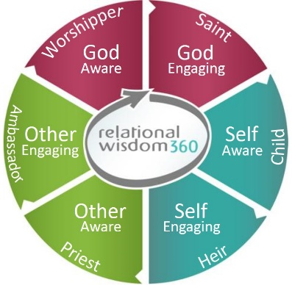
God-aware: True worshippers delight in remembering God’s deeds and exalting his character (Ps. 77:11; 79:13).

Slide 30
God-engaging: Sincere saints are highly motivated to be faithful and obedient to Christ (Eph. 1:1, 2 Cor. 4:2).

Slide 31
Self-aware: Godly children humbly admit their limitations and ask for their Father’s guidance and help as they seek to imitate the character of Christ (Col. 3:12-15).

Slide 32
Self-engaging: Heirs of God understand the gifts and privileges God has bestowed upon them and seek to be faithful stewards by leading disciplined and productive lives (Matt. 25:14-23).

Slide 33
Other-aware: Priests are called to be compassionate as they discern and minister to the weaknesses and needs of others
(Heb. 4:15).

Slide 34
Other-engaging: Ambassadors go forth on behalf of their King to proclaim his will, reflect his love and serve those whom he desires to bless (2 Cor. 5:20; Eph. 6:20).

Slide 35
Peacemakers have been reconciled to God through Christ and delight to imitate him by using all their royal titles to reconcile people to God and their neighbors (Eph. 5:1).

Slide 36
- D -
Grow in Relational Wisdom and Peacemaking

Slide 37
Reconciling Two Stubborn Scientists

Slide 38
Start with Yourself
“Practice these things, immerse yourself in them, so that all may see your progress.”
1 Timothy 4:15
To learn, read
To understand, write
To improve, practice
To master, teach
rw360.org/xenos23

Slide 39
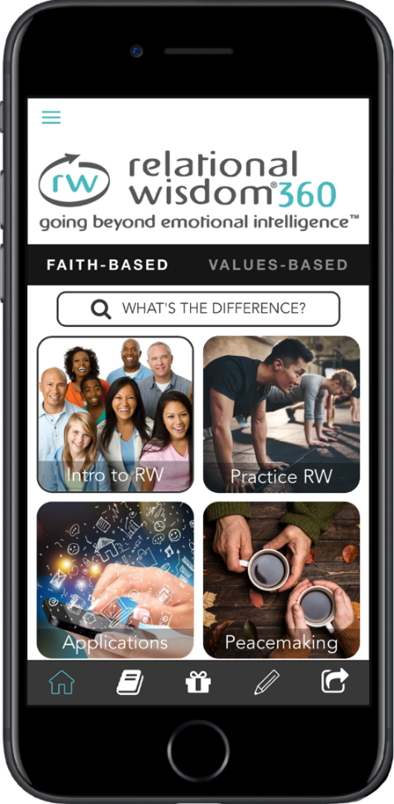
RW and Peacemaking at Your Fingertips
“RW360”

Slide 40
Free Blog and Downloads

Slide 41
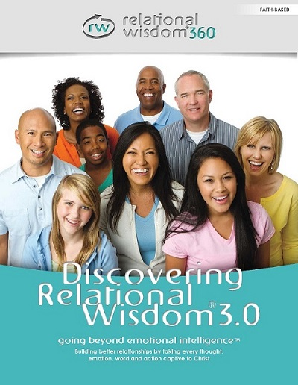
Foundational Training

Slide 42
Use RW for Witnessing

Slide 43
Group Study Sets

Slide 44
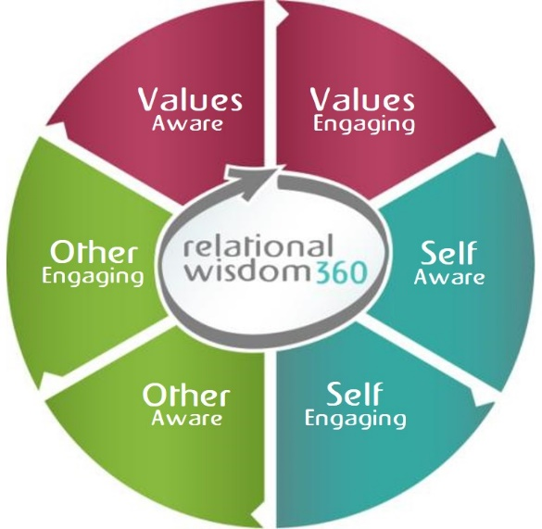
Community Outreach and Evangelism

Slide 45
Billings, MT / Nov 2-5

Slide 46
Pdf at rw360.org/xenos23

