Slide 1
2 Corinthians 8 & 9
Grace to Give

Slide 2
Principles that inform how Christians approach financial giving

Slide 3
Principles that inform how Christians approach financial giving are often ignored.

Slide 4
“I’ve owned three different jets in my life, and I’ve used them… burning them up for the Lord Jesus Christ.”
“God said to me, ‘I want you to believe me for a Falcon 7X,” so I said, ‘OK.’”

Slide 5
“I really believe, if Jesus was physically on the earth today, he wouldn’t be riding a donkey.”

Slide 6
God wants Christians to be generous
Acts 20:35 “It’s more blessed to give than receive.”

Slide 7
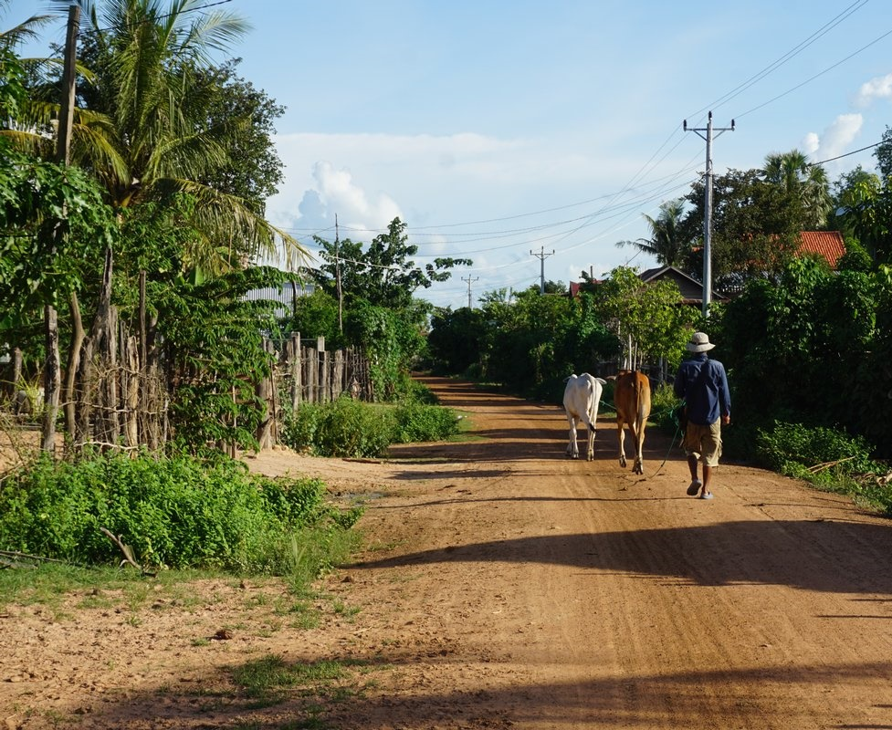
God wants Christians to be generous
There will be great opportunities to be generous

Slide 8
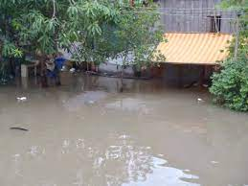
God wants Christians to be generous
There will be great opportunities to be generous

Slide 9
God wants Christians to be generous
There will be great opportunities to be generous
When you do give, it can be very rewarding

Slide 10
God wants Christians to be generous
There will be great opportunities to be generous
When you do give, it can be very rewarding
But God gives us principles to guide how we go about giving

Slide 11
2 Corinthians 8:1 Now I want you to know, dear brothers and sisters, what God in his kindness has done through the churches in Macedonia.

Slide 12
2 Corinthians 8:1 Now I want you to know, dear brothers and sisters, what God in his grace has done through the churches in Macedonia.
God’s grace is at the heart of giving
How God has been generous with us
How God empowers us to be generous with others

Slide 13
2 Corinthians 8:1 Now I want you to know, dear brothers and sisters, what God in his grace has done through the churches in Macedonia. 2 They are being tested by many troubles, and they are very poor. But they are also filled with abundant joy, which has overflowed in rich generosity.
Grace-based giving isn’t bound by our circumstances

Slide 14
2 Corinthians 8:1 Now I want you to know, dear brothers and sisters, what God in his grace has done through the churches in Macedonia. 2 They are being tested by many troubles, and they are very poor. But they are also filled with abundant joy, which has overflowed in rich generosity.
Grace-based giving isn’t bound by our circumstances

Slide 15
2 Corinthians 8:1 Now I want you to know, dear brothers and sisters, what God in his grace has done through the churches in Macedonia. 2 They are being tested by many troubles, and they are very poor. But they are also filled with abundant joy, which has overflowed in rich generosity.
Grace-based giving isn’t bound by our circumstances

Slide 16
2 Corinthians 8:1 Now I want you to know, dear brothers and sisters, what God in his grace has done through the churches in Macedonia. 2 They are being tested by many troubles, and they are very poor. But they are also filled with abundant joy, which has overflowed in rich generosity.
Grace-based giving isn’t bound by our circumstances
It’s willing to give during hard times

Slide 17
2 Corinthians 8:3 For I can testify that they gave not only what they could afford, but far more. And they did it of their own free will.
Grace-based giving isn’t bound by our circumstances
It’s willing to give during hard times

Slide 18
Romans 8:32 Since he did not spare even his own Son but gave him up for us all, won’t he also give us everything else?
Grace-based giving isn’t bound by our circumstances
It’s willing to give during hard times

Slide 19
2 Corinthians 8:4 They begged us again and again for the privilege of sharing in the gift for the believers in Jerusalem.
Grace-based giving isn’t bound by our circumstances
It’s willing to give during hard times
It’s eager to give during hard times

Slide 20
2 Corinthians 8:8 I am not commanding you to do this… 9 You know the generous grace of our Lord Jesus Christ. Though he was rich, yet for your sakes he became poor, so that by his poverty he could make you rich.
Grace-based giving is inspired by Christ

Slide 21
2 Corinthians 8:8 I am not commanding you to do this… 9 You know the generous grace of our Lord Jesus Christ. Though he was rich, yet for your sakes he became poor, so that by his poverty he could make you rich.
Grace-based giving is inspired by Christ
We feel a lot of guilt associated with giving…
…but will that drive us to be generous?

Slide 22
2 Corinthians 8:12 Whatever you give is acceptable if you give it eagerly. And give according to what you have, not what you don’t have. 13 Of course, I don’t mean your giving should make life easy for others and hard for yourselves…
Grace-based giving shares resources with those in need

Slide 23
…I only mean that there should be some equality. 14 Right now you have plenty and can help those who are in need. Later, they will have plenty and can share with you when you need it. In this way, things will be equal.
Grace-based giving shares resources with those in need

Slide 24
…I only mean that there should be some equality. 14 Right now you have plenty and can help those who are in need. Later, they will have plenty and can share with you when you need it. In this way, things will be equal.
Grace-based giving shares resources with those in need
Most of us have a surplus we can share

Slide 25
“1 billion children world-wide are without access to education, health care, adequate housing, good nutrition, sanitation, or clean water.”
“356 million children living in extreme poverty, forced to survive on $1.90/day.” – The World Economic Forum

Slide 26
2 Corinthians 8:15 As the Scriptures say, “Those who gathered a lot had nothing left over, and those who gathered only a little had enough.”
Grace-based giving shares resources with those in need
Most of us have a surplus we can share
Humanitarian Aid & Development Fund

Slide 27
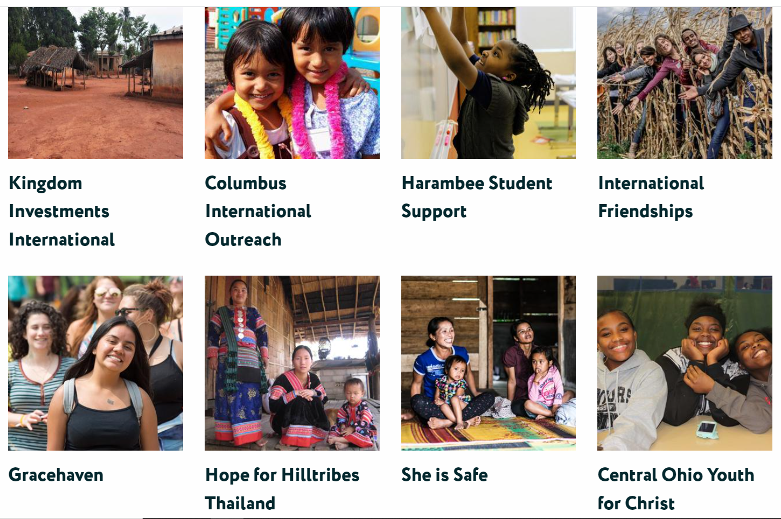
dwellcc.org/missions/aidfund

Slide 28
2 Corinthians 8:15 As the Scriptures say, “Those who gathered a lot had nothing left over, and those who gathered only a little had enough.”
Grace-based giving shares resources with those in need
But what about bad players?
We need a way to prevent fraud.

Slide 29
2 Corinthians 9:5 “I thought I should send these brothers ahead of me to make sure the gift you promised is ready…
Grace-based giving shares resources with those in need
But what about bad players?
We need a way to prevent fraud.

Slide 30
2 Corinthians 8:17 Titus welcomed our request that he visit you again… 18 We are also sending another brother with Titus. All the churches praise him as a preacher of the Good News.
Grace-based giving shares resources with those in need
But what about bad players?
We need a way to prevent fraud.

Slide 31
2 Corinthians 8:19 He was appointed by the churches to accompany us as we take the offering to Jerusalem—a service that glorifies the Lord and shows our eagerness to help.
Grace-based giving shares resources with those in need
But what about bad players?
We need a way to prevent fraud.

Slide 32
2 Corinthians 8:20 We are traveling together to guard against any criticism for the way we are handling this generous gift. 21 We are careful to be honorable before the Lord, but we also want everyone else to see that we are honorable.
Grace-based giving shares resources with those in need
But what about bad players?
We need a way to prevent fraud.

Slide 33
2 Corinthians 8:22 We are also sending with them another of our brothers who has proven himself many times and has shown on many occasions how eager he is. He is now even more enthusiastic because of his great confidence in you.
Grace-based giving shares resources with those in need
But what about bad players?
We need a way to prevent fraud.

Slide 34
2 Corinthians 8:22 We are also sending with them another of our brothers who has proven himself many times and has shown on many occasions how eager he is. He is now even more enthusiastic because of his great confidence in you.
Grace-based giving is accountable
Two people signing checks over $50
Open books
Audits
Modest incomes
Plurality

Slide 35
2 Corinthians 8:10 Here is my advice: It would be good for you to finish what you started a year ago…
Grace-based giving remembers God’s role
It’s easy to find reasons not to give
But God can do a lot with a little…

Slide 36
2 Corinthians 9:6 Remember this—a farmer who plants only a few seeds will get a small crop. But the one who plants generously will get a generous crop.
Grace-based giving remembers God’s role
It’s easy to find reasons not to give
But God can do a lot with a little…

Slide 37
2 Corinthians 9:6 Remember this—a farmer who plants only a few seeds will get a small crop. But the one who plants generously will get a generous crop.
Grace-based giving remembers God’s role
It’s easy to find reasons not to give
But God can do a lot with a little…
…& gives to those who are generous

Slide 38
2 Corinthians 9:8 And God will generously provide all you need. Then you will always have everything you need and plenty left over to share with others…
Grace-based giving remembers God’s role
It’s easy to find reasons not to give
But God can do a lot with a little…
…& gives to those who are generous

Slide 39
2 Corinthians 9:10 For God is the one who provides seed for the farmer and then bread to eat. In the same way, he will provide and increase your resources and then produce a great harvest of generosity in you.
Grace-based giving remembers God’s role
It’s easy to find reasons not to give
But God can do a lot with a little…
…& gives to those who are generous

Slide 40
2 Corinthians 9:10 For God is the one who provides seed for the farmer and then bread to eat. In the same way, he will provide and increase your resources and then produce a great harvest of generosity in you.
Grace-based giving remembers God’s role
11 Yes, you will be enriched in every way so that you can always be generous…
It’s easy to find reasons not to give
But God can do a lot with a little…
…& gives to those who are generous

Slide 41
2 Corinthians 9:10 For God is the one who provides seed for the farmer and then bread to eat. In the same way, he will provide and increase your resources and then produce a great harvest of generosity in you.
Grace-based giving remembers God’s role
11 Yes, you will be enriched in every way so that you can always be generous…
It’s easy to find reasons not to give
But God can do a lot with a little…
…& gives to those who are generous

Slide 42
2 Corinthians 9:10 For God is the one who provides seed for the farmer and then bread to eat. In the same way, he will provide and increase your resources and then produce a great harvest of generosity in you.
Grace-based giving remembers God’s role
11 Yes, you will be enriched in every way so that you can always be generous…
It’s easy to find reasons not to give
But God can do a lot with a little…
…& gives to those who are generous

Slide 43
2 Corinthians 9:11b And when we take your gifts to those who need them, they will thank God. 12 So two good things will result from this ministry of giving—the needs of the believers in Jerusalem will be met, and they will joyfully express their thanks to God.
Grace-based giving causes recipients to give thanks & glorify God

Slide 44
2 Corinthians 9:11b And when we take your gifts to those who need them, they will thank God. 12 So two good things will result from this ministry of giving—the needs of the believers in Jerusalem will be met, and they will joyfully express their thanks to God.
Grace-based giving causes recipients to give thanks & glorify God

Slide 45
2 Corinthians 9:11b And when we take your gifts to those who need them, they will thank God. 12 So two good things will result from this ministry of giving—the needs of the believers in Jerusalem will be met, and they will joyfully express their thanks to God.
Grace-based giving causes recipients to give thanks & glorify God

Slide 46
2 Corinthians 9:13 As a result of your ministry, they will give glory to God.
Grace-based giving causes recipients to give thanks & glorify God
People see in a new way how good God is

Slide 47
2 Corinthians 9:14 And they will pray for you with deep affection because of the overflowing grace God has given to you. 15 Thank God for this gift too wonderful for words!
Grace-based giving causes recipients to give thanks & glorify God
People see in a new way how good God is

Slide 48
WHAT’S NEXT?

Slide 49
Preserve the link between giving and grace!
Set up a budget.
Realize, as with any ministry, you don’t give in your own power.
Get educated about good giving opportunities…
…including supporting the church you attend (Galatians 6:6; 1 Timothy 5:17-18).
Help people connect your generosity to the gospel.
Start looking forward to the impact!

