Slide 2
(Jn. 12:1) Six days before the Passover, Jesus came to Bethany, where Lazarus lived, whom Jesus had raised from the dead.
² Here a dinner was given in Jesus’ honor. Martha served, while Lazarus was among those reclining at the table with him.

Slide 3
(Jn. 12:3) Then Mary took about a pint of pure nard, an expensive perfume.

Slide 4
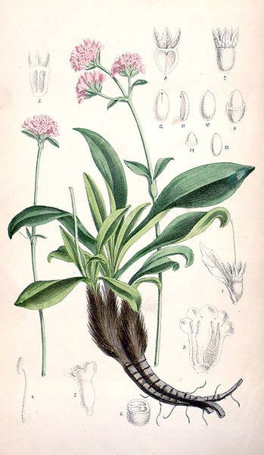
(Jn. 12:3) Then Mary took about a pint of pure nard, an expensive perfume.
“Pure nard.”
“Fragrant oil from the root of the nard plant of the mountains of northern India.”
Craig Keener, The Gospel of John (Baker, 2003), 863.
“Rich rose red and sweetly scented.”
Andreas Köstenberger, John (Grand Rapids, MI: Baker Academic, 2004), p.360-361.

Slide 9
(Jn. 12:3) Then Mary took about a pint of pure nard, an expensive perfume.
“Pure nard.”
“Fragrant oil from the root of the nard plant of the mountains of northern India”
Craig Keener, The Gospel of John (Baker, 2003), 863.
“Rich rose red and sweetly scented.”
Andreas Köstenberger, John (Grand Rapids, MI: Baker Academic, 2004), p.360-361.

Slide 10
(Jn. 12:3) Then Mary took about a pint of pure nard, an expensive perfume.
“Pint”
Roughly 12 ounces.
“A pound” (litra) is equivalent to the Latin libra
Leon Morris, John (1995), p.511.
Worth roughly a year’s salary!
Verse 5
This was likely Mary’s dowry for her future marriage.

Slide 11
(Jn. 12:3) Then Mary took about a pint of pure nard, an expensive perfume.
Mary used all of it on Jesus!
(Mk. 14:3) Mary broke open the jar and poured the perfume over his head.

Slide 12
(Jn. 12:3) Then Mary took about a pint of pure nard, an expensive perfume.
She poured it on Jesus’ feet
and wiped his feet with her hair.
Touching or cleaning someone’s feet was reserved for slaves.
John 1:27; 13:5; 1 Samuel 25:41; Mekhilta on Exodus 21:2; Kethub 96a.
Married women didn’t let down their hair in public.
m. Ketubot 7:6; Sotah 1:5; Sipre on Numbers 11.2.3; The Fathers according to Rabbi Nathan 3; 17A; 14, §35B; Joseph and Asenath 15:1-2; 18:6; Philo, 230.

Slide 13
(Jn. 12:3) Then Mary took about a pint of pure nard, an expensive perfume.
She poured it on Jesus’ feet
and wiped his feet with her hair.
And the house was filled with the fragrance of the perfume.
(Mt. 26:8) The disciples were indignant when they saw this.
“What a waste!” they said.

Slide 14
(Jn. 12:4) But Judas Iscariot, the disciple who would soon betray him, said,
⁵ “That perfume was worth a year’s wages. It should have been sold and the money given to the poor.”
Did Judas have a point?

Slide 15
(Jn. 12:6) Judas did not say this because he cared for the poor.
He was a thief, and since he was in charge of the disciples’ money,
he often stole some for himself.

Slide 16
(Jn. 12:7) Jesus replied,
“Leave her alone. It was intended that she should save this perfume for the day of my burial.”
It was common practice to anoint bodies with aromatic oils.
Testament of Job 31:2; m. Shabbat 23; Homer, Iliad 18.351; 24.582; Virgil, Aeneid 6.219; Martial, Epigrams 3.12.

Slide 17
(Jn. 12:8) “You will always have the poor among you, but you will not always have me.”
Deuteronomy 15:11
(Mt. 26:13) Jesus said, “I tell you the truth, wherever the Good News is preached throughout the world, this woman’s deed will be remembered and discussed.”

Slide 18
How did Judas react?
He tried to take what he could.
John 12:4-6
“Judas… went to the leading priests and asked, ‘How much will you pay me to betray Jesus to you?’
They gave him thirty pieces of silver.”
Matthew 26:14-15
To Judas, anything spent on Jesus was a waste!

Slide 19
How did the disciples react?
The disciples were indignant when they saw this. “What a waste!” they said.
Matthew 26:8
What is “waste”?
Spending your resources on something of lesser value.
“The movie was a waste of money.”
“He wasted his scholarship by playing too many video games.”
“She wasted her future on drugs.”

Slide 20
How did the disciples react?
The disciples were indignant when they saw this. “What a waste!” they said.
Matthew 26:8
What is “waste”?
Spending your resources on something of lesser value.
“The movie was a waste of money.”
“He wasted his scholarship by playing too many video games.”
“She wasted her future on drugs.”
Is it worth expending your adult life on Christianity?

Slide 21
How did the disciples react?
The disciples were indignant when they saw this. “What a waste!” they said.
Matthew 26:8
Is Christianity true?
If not, don’t waste your time!
If so, don’t waste your time!

Slide 22
How did the disciples react?
The disciples were indignant when they saw this. “What a waste!” they said.
Matthew 26:8
Is Christianity true?
If not, don’t waste your time!
If so, don’t waste your time!
Will we all meet God someday?
Are Jesus’ promises true?
Is Heaven a reality? And what will matter in eternity?

Slide 23
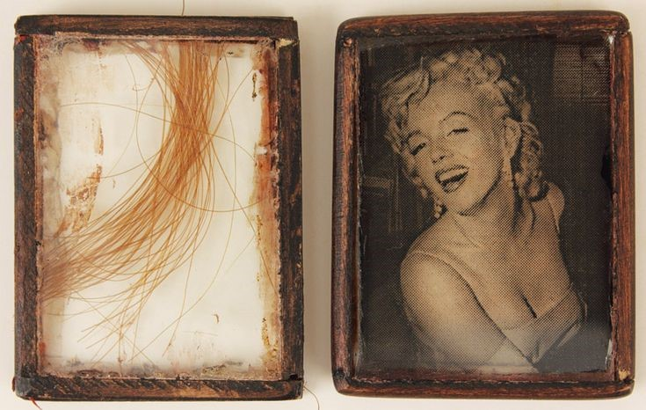
Celebrity Hair

Slide 24
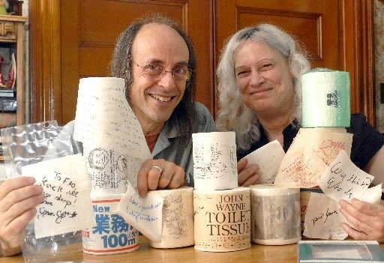
Toilet Papers

Slide 25
Banana Stickers

Slide 26
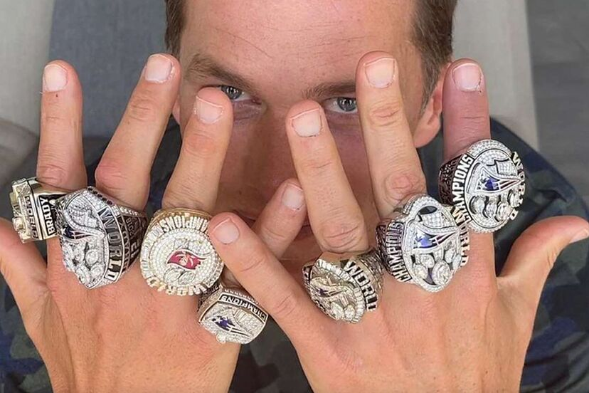
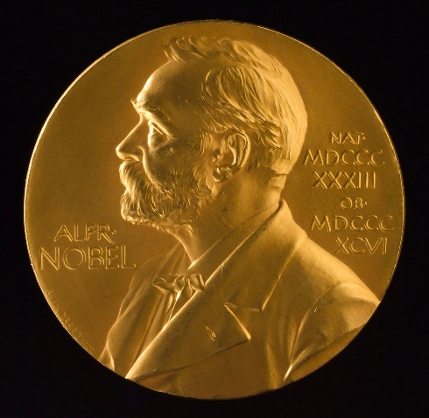

Slide 27
How did the disciples react?
The disciples were indignant when they saw this. “What a waste!” they said.
Matthew 26:8
Is Christianity true?
If not, don’t waste your time!
If so, don’t waste your time!
Will we all meet God someday?
Are Jesus’ promises true?
Is Heaven a reality? And what will matter in eternity?

Slide 28
How did the disciples react?
The disciples were indignant when they saw this. “What a waste!” they said.
Matthew 26:8
In many ways, I can sympathize with Judas’ reaction… but the disciples?
(e.g. couple downsizing their house)

Slide 29
How did Jesus react?
Jesus said, “Why are you bothering this woman? She has done a beautiful thing to me.”
Matthew 26:10
Jesus said, “Wherever the Good News is preached throughout the world, this woman’s deed will be remembered and discussed.”
Matthew 26:13

Slide 30
How did Mary react?
The text doesn’t say.
But one day, we are going to meet Mary face-to-face and ask:
“Was it worth it?”

Slide 31
How did you react?
What comes to your mind when you think about dedicating an area of your life to Christ?
Do you think you’ll ever regret trusting Christ with an area of your life?
Who do you plan to open up with about that tonight?

