Slide 1
Holding the Center
Keeping God at the Center of Your Family

Slide 2
Parenting is Sacred
Psalm 127:
3 Children are a heritage from the Lord,
offspring a reward from him.
4 Like arrows in the hands of a warrior
are children born in one’s youth.
5 Blessed is the man
whose quiver is full of them.

Slide 3
Parenting is Sacred
Proverbs 17:6
Children’s children are a crown to the aged,
and parents are the pride of their children.

Slide 4
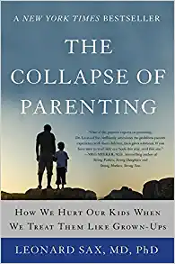
Childhood: The interval between weaning and sexual maturity
Adolescence: the time between the onset of sexual maturity and full maturity (physical development as well as brain development)
Rabbits: 10% in childhood
Horses: 10% in childhood, 4% in adolescence
Humans: 15% in childhood, and 15-16% in adolescence

Slide 5
What is the point? Why are we humans so different from other animals?
The answer is culture. When anthropologists use the term “culture,” they are referring to the collection of practices and customs which are characteristic of individuals in one community but which are not shared by individuals of the same species who live in another community.

Slide 6
They also mean that the differences between the two communities are not genetically programmed. Children and adolescents learn these customs and practices either by watching the adults or by receiving active instruction from the adults.

Slide 7
Parenting is Sacred
Proverbs 22:6
Train up a child in the way he should go,
Even when he grows older he will not abandon it.

Slide 8
Parenting is Sacred
Deuteronomy 6:6, 7
These words, which I am commanding you today, shall be on your heart.
7 And you shall repeat them diligently to your sons and speak of them when you sit in your house, when you walk on the road, when you lie down, and when you get up.

Slide 9
Parenting is Sacred
Ephesians 6:4
Fathers, do not exasperate your children; instead, bring them up in the training and instruction of the Lord.

Slide 10
Parenting is Sacred
Proverbs 1:8, 9
Listen, my son, to your father’s instruction
and do not forsake your mother’s teaching.
9 They are a garland to grace your head
and a chain to adorn your neck.

Slide 11
Howard Hendricks, Leadership for the Family
Your objectives determine your outcomes. You achieve that for which you aim. People start in a marriage and in a family with a lot of dreams and a lot of ideals. But oftentimes they have never spelled out their objectives.

Slide 12
Our Parenting Objective
Matthew 22:37-40
37 Jesus replied, “ ‘Love the Lord your God with all your heart and with all your soul. Love him with all your mind.’ 38 This is the first and most important commandment. 39 And the second is like it. ‘Love your neighbor as you love yourself.’ 40 Everything that is written in the Law and the Prophets is based on these two commandments.”

Slide 13
Howard Hendricks, Leadership for the Family
First of all maintaining personal and spiritual integrity, second developing marital intimacy, and third fulfilling parental responsibility. Mark the order. You have to ask yourself, what do I have to give my children?

Slide 14
God
Matthew 6:33
But seek first His kingdom and His righteousness, and all these things will be given to you as well.

Slide 15
Marriage
Genesis 2:24
That is why a man leaves his father and mother and is united to his wife, and they become one flesh.

Slide 16
Marriage
Ephesians 5
21 Submit to one another out of reverence for Christ.
22 Wives, submit yourselves to your own husbands as you do to the Lord.
25 Husbands, love your wives, just as Christ loved the church and gave himself up for her

Slide 17
Howard Hendricks, Developing Convictions
A conviction is a principle that I cherish or prize highly enough that I practice it in my life. There is a vast difference between your belief system and your convictional system. Your belief system is something you will argue for. Your convictional system is something you will die for.

Slide 18
Child Centered Parenting
Our Conversations

Slide 19
Child Centered Parenting
Our Conversations:
“Mom, mom, mom, mom…”
Talking about our children

Slide 20
Child Centered Parenting
Our Conversations
Our Home

Slide 21
Child Centered Parenting
Our Home:
Meal times
Cleaning
Living spaces

Slide 22
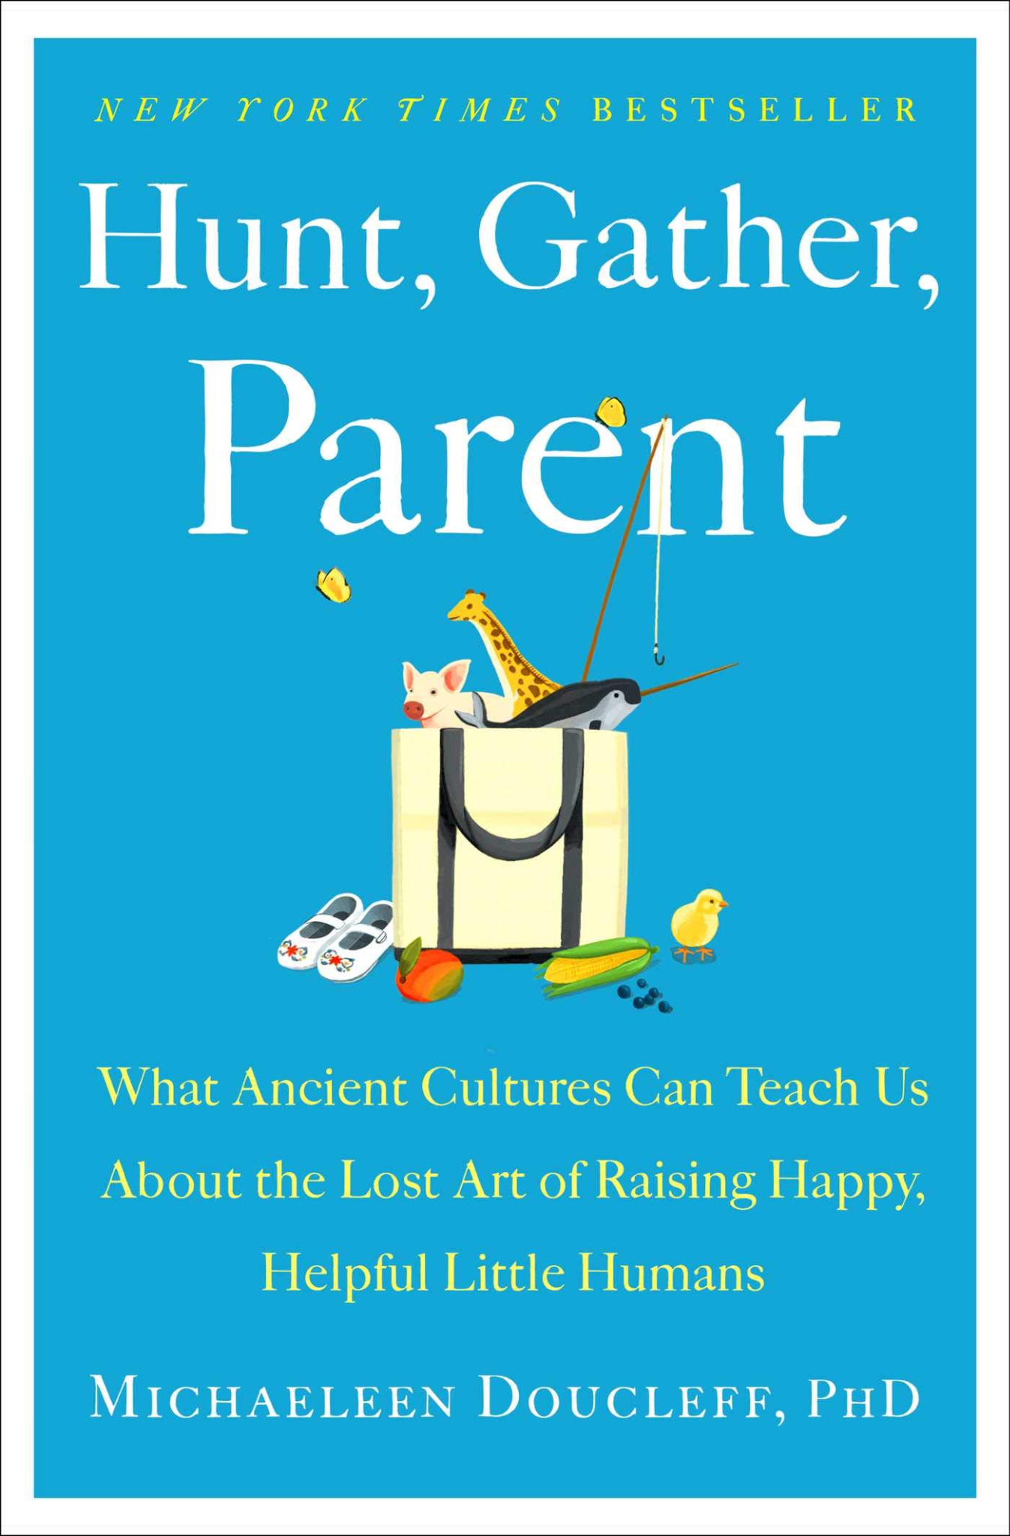
The answer has more to do with the Industrial Revolution- and burgeoning consumerism- than it does with cognitive science or child development.
Back in the early 1800s, all kids in the U.S. pretty much played in the same way- no matter if they were rich, poor, or somewhere in between, they didn’t have toys in their homes. Instead, they did what kids have done for two hundred thousand years; they created their own toys with objects they found around the house or outside…

Slide 23
In the mid- 1800s, a new idea in psychology emerged and collided with the Industrial Revolution- and Western children have never played the same way again. Parenting experts began advocating for the “use of blocks, in the school and at home, to teach values of order as well as building skills,” and for the use of “board games to enhance powers of planning and order,” Howard wrote.

Slide 24
A few decades later, the Industrial Revolution ushered in countless new ways to produce toys, dolls, puzzles, and books- in bulk. Never before were children’s trinkets cheaper to produce or more appealing to children. Toys were more colorful; dolls were more lifelike; and both were more widely advertised to eager parents who had more disposable income in their pockets.

Slide 25
Child Centered Parenting
Our Conversations
Our Home
Our Time

Slide 26
Child Centered Parenting
Our Time:
All the schedules

Slide 27
So Christina undertook a massive project. She read and reviewed more than 650 parenting books and manuals, dating all the way back to the mid-1700s; around this time “experts” began writing manuals for “intelligent parents,” and the field of pediatrics began to emerge as a distinct discipline….

Slide 28
The book’s conclusion is a whopper: Much of the parenting advice out there today isn’t based on “scientific or medical studies,” or even on traditional knowledge passed down from grandmas to moms for centuries. Instead, a big chunk of it comes from centuries-old pamphlets- often written by male doctors- intended for foundling hospitals, where nurses cared for dozens, even hundreds, of abandoned babies, all at once.

Slide 29
Free yourself from advice overload by remembering that we got to this point in human history without the benefit of child-rearing manuals, pregnancy diet books, or potty training treatises. If you seek parenting advice, first try asking an older parent you admire. She’ll be thrilled, and her advice won’t last 378 pages.

Slide 30
Our brains essentially have two modes, focused and unfocused. Focused mode is a mind at attention. It’s on when we’re processing outside information, completing a task, checking our cellphone, watching tv, listening to a podcast, having a conversation, or anything else that requires us to attend to the outside world.

Slide 31
Unfocused mode occurs when we’re not paying attention. It’s inward mind-wandering, a rest state that restores and rebuilds the resources needed to work better and more efficiently in the focused state. Time in unfocused mode is critical to get shit done, tap into creativity, process complicated information, and more…
Our collective lack of boredom may be causing us to reach near-crisis levels of mental fatigue.

Slide 32
<Torrence Test of Creative Thinking>
And now we’ve killed off one of the main drivers of creativity: mind-wandering. The result? A researcher at the University of William and Mary analyzed 300,000 Torrance Test scores since the 1950s. She found that the creativity scores began to nosedive in 1990, leading her to conclude that we’re now facing a “creativity crisis.”

Slide 33
Child Centered Parenting
Our Time:
All the schedules
Prioritizing our children’s schedules over everything else

Slide 34
Howard Hendricks, Leadership for the Family
There's no conflict of duty in Christian experience… Your call to the ministry is not in conflict with your call to be a father, a husband, a mother, a wife. And I have discovered that personal failure does not arise from overwork. It arises from ambiguity of mission; not really knowing what are my objectives: What do I want, and what price am I willing to pay?

Slide 35
Dangers of Child Centered Parenting
Self-centeredness
Child becomes the authority

Slide 36
Holding the Center
SHOW your children what God values

Slide 37
Holding the Center
SHOW your children what God values
TEACH your children what God values

Slide 39
Professor Dweck says that you should praise kids based not on their identity (smart/not smart) but on their behavior (trying hard/not trying hard). In the realm of promoting cognitive achievement- motivating kids to learn stuff in school- there is good evidence to support her belief.

Slide 40
But teaching virtues may be different…Should I say to my daughter “That was a very kind thing you did” or should I say “You are a very kind person”? Does it make any difference? If Professor Dweck’s rule applies in the realm of virtue, then praising the behavior would be a better strategy than making a statement about identity. But there is now good evidence that when it comes to teaching virtue, Professor Dweck’s approach is precisely the wrong way.

Slide 41
When it comes to teaching virtue, identity seems to work better than behavior. “You are a very kind person” works better than “that was a very kind thing you did.” In one study, students were less likely to cheat when they were told that the researchers were studying the prevalence of “cheaters.” The proportion of students who cheated more than doubled when the researchers instead said that they were studying the prevalence of “cheating.”...

Slide 42
Likewise, researchers have recently found that young children are more likely to help with a project if they are encouraged to “be a helper” rather than merely asked “to help.”...
In reality, behavior influences identity and eventually becomes identity.

Slide 43
Holding the Center
SHOW your children what you value
TEACH your children what you value
Teach Humility

Slide 44
The right kind of humility help you to recognize your own shortcomings. To be better prepared. To understand the risks. And to take those risks courageously, when necessary.
The antidote to the culture of bloated self-esteem is the culture of humility. If I am in the culture of humility, then I rejoice at the success of others, and I am happy with my portion.

Slide 45
The culture of humility leads to gratitude, appreciation, and contentment. The key to lasting happiness is contentment….

Slide 46
Holding the Center
SHOW your children what God values
TEACH your children what God values
Teach Humility
Enjoy time with your children

Slide 47
