Slide 1
Unity
Ephesians 4:1-6

Slide 2
Ephesians
Open, circulating letter (need-to-knows)
Chapter 1: “Every spiritual blessing in Christ”
Prayers for open eyes to realize how blessed
Chapter 2: “You were… but God”
Ch. 3 “For this reason, I, Paul…”
About to give the first command, but can’t yet
“Manifold wisdom” and “love that surpasses knowledge”
⁸ For it is by grace you have been saved, through faith—and this is not from yourselves, it is the gift of God— ⁹ not by works, so that no one can boast.

Slide 3
Ephesians 4
As a prisoner for the Lord, then, I urge you to live a life worthy of the calling you have received. ² Be completely humble and gentle; be patient, bearing with one another in love. ³ Make every effort to keep the unity of the Spirit through the bond of peace. ⁴ There is one body and one Spirit, just as you were called to one hope when you were called; ⁵ one Lord, one faith, one baptism; ⁶ one God and Father of all, who is over all and through all and in all.
⁷ But to each one of us grace has been given as Christ apportioned it.

Slide 4
Ephesians 4
As a prisoner for the Lord, then, I urge you to live a life worthy of the calling you have received. ² Be completely humble and gentle; be patient, bearing with one another in love. ³ Make every effort to keep the unity of the Spirit through the bond of peace. ⁴ There is one body and one Spirit, just as you were called to one hope when you were called; ⁵ one Lord, one faith, one baptism; ⁶ one God and Father of all, who is over all and through all and in all.
⁷ But to each one of us grace has been given as Christ apportioned it.

Slide 5
Ephesians 4
As a prisoner for the Lord, then, I urge you to live a life worthy of the calling you have received. ² Be completely humble and gentle; be patient, bearing with one another in love. ³ Make every effort to keep the unity of the Spirit through the bond of peace. ⁴ There is one body and one Spirit, just as you were called to one hope when you were called; ⁵ one Lord, one faith, one baptism; ⁶ one God and Father of all, who is over all and through all and in all.
⁷ But to each one of us grace has been given as Christ apportioned it.

Slide 6
Ephesians 4
swim
“I follow Jesus in my own way. I don’t need to get into community for it.”
As a prisoner for the Lord, then, I urge you to live a life worthy of the calling you have received. ² Be completely humble and gentle; be patient, bearing with one another in love. ³ Make every effort to keep the unity of the Spirit through the bond of peace. ⁴ There is one body and one Spirit, just as you were called to one hope when you were called; ⁵ one Lord, one faith, one baptism; ⁶ one God and Father of all, who is over all and through all and in all.
⁷ But to each one of us grace has been given as Christ apportioned it.
water
Community
“Feed my sheep”
Greatest command
“If you say you love God…”
“One another” commands
UNITY

Slide 7
How Christian Unity Works
1) A response to the Good News
5 features
As a prisoner for the Lord, then, I urge you to live a life worthy of the calling you have received. ² Be completely humble and gentle; be patient, bearing with one another in love. ³ Make every effort to keep the unity of the Spirit through the bond of peace. ⁴ There is one body and one Spirit, just as you were called to one hope when you were called; ⁵ one Lord, one faith, one baptism; ⁶ one God and Father of all, who is over all and through all and in all.
⁷ But to each one of us grace has been given as Christ apportioned it.

Slide 8
How Christian Unity Works
1) A response to the Good News
As a prisoner for the Lord, then, I urge you to live a life worthy of the calling you have received. ² Be completely humble and gentle; be patient, bearing with one another in love. ³ Make every effort to keep the unity of the Spirit through the bond of peace. ⁴ There is one body and one Spirit, just as you were called to one hope when you were called; ⁵ one Lord, one faith, one baptism; ⁶ one God and Father of all, who is over all and through all and in all.
⁷ But to each one of us grace has been given as Christ apportioned it.
For you know that it was not with perishable things such as silver or gold that you were redeemed…, ¹⁹ but with the precious blood of Christ, a lamb without blemish or defect. [1 pet. 1:18-19]
The irony of interpreting this in a way that undoes grace… after 3 chapters of grace.
“axios”- fitting, due, suitable
Pay it… forward

Slide 9
How Christian Unity Works
1) A response to the Good News
“to grasp how wide and long and high and deep is the love of Christ and to know this love that surpasses knowledge”
As a prisoner for the Lord, then, I urge you to live a life worthy of the calling you have received. ² Be completely humble and gentle; be patient, bearing with one another in love. ³ Make every effort to keep the unity of the Spirit through the bond of peace. ⁴ There is one body and one Spirit, just as you were called to one hope when you were called; ⁵ one Lord, one faith, one baptism; ⁶ one God and Father of all, who is over all and through all and in all.
⁷ But to each one of us grace has been given as Christ apportioned it.
What would be a fitting response to the Good News?
Propels us into COMMUNITY
Someone I’M ALREADY TRYING TO SERVE is making it hard for me TO SERVE THEM.
They need X but I would rather do Y….
When we’re feeling
stretched.

Slide 10
How Christian Unity Works
1) A response to the Good News
As a prisoner for the Lord, then, I urge you to live a life worthy of the calling you have received. ² Be completely humble and gentle; be patient, bearing with one another in love. ³ Make every effort to keep the unity of the Spirit through the bond of peace. ⁴ There is one body and one Spirit, just as you were called to one hope when you were called; ⁵ one Lord, one faith, one baptism; ⁶ one God and Father of all, who is over all and through all and in all.
⁷ But to each one of us grace has been given as Christ apportioned it.

Slide 11
How Christian Unity Works
2) Relational, not Organizational
As a prisoner for the Lord, then, I urge you to live a life worthy of the calling you have received. ² Be completely humble and gentle; be patient, bearing with one another in love. ³ Make every effort to keep the unity of the Spirit through the bond of peace. ⁴ There is one body and one Spirit, just as you were called to one hope when you were called; ⁵ one Lord, one faith, one baptism; ⁶ one God and Father of all, who is over all and through all and in all.
⁷ But to each one of us grace has been given as Christ apportioned it.
Let’s eradicate organizational disunity between churches!

Slide 12
How Christian Unity Works
2) Relational, not Organizational
As a prisoner for the Lord, then, I urge you to live a life worthy of the calling you have received. ² Be completely humble and gentle; be patient, bearing with one another in love. ³ Make every effort to keep the unity of the Spirit through the bond of peace. ⁴ There is one body and one Spirit, just as you were called to one hope when you were called; ⁵ one Lord, one faith, one baptism; ⁶ one God and Father of all, who is over all and through all and in all.
⁷ But to each one of us grace has been given as Christ apportioned it.
Let’s eradicate organizational disunity between churches!
Let’s not.

Slide 13
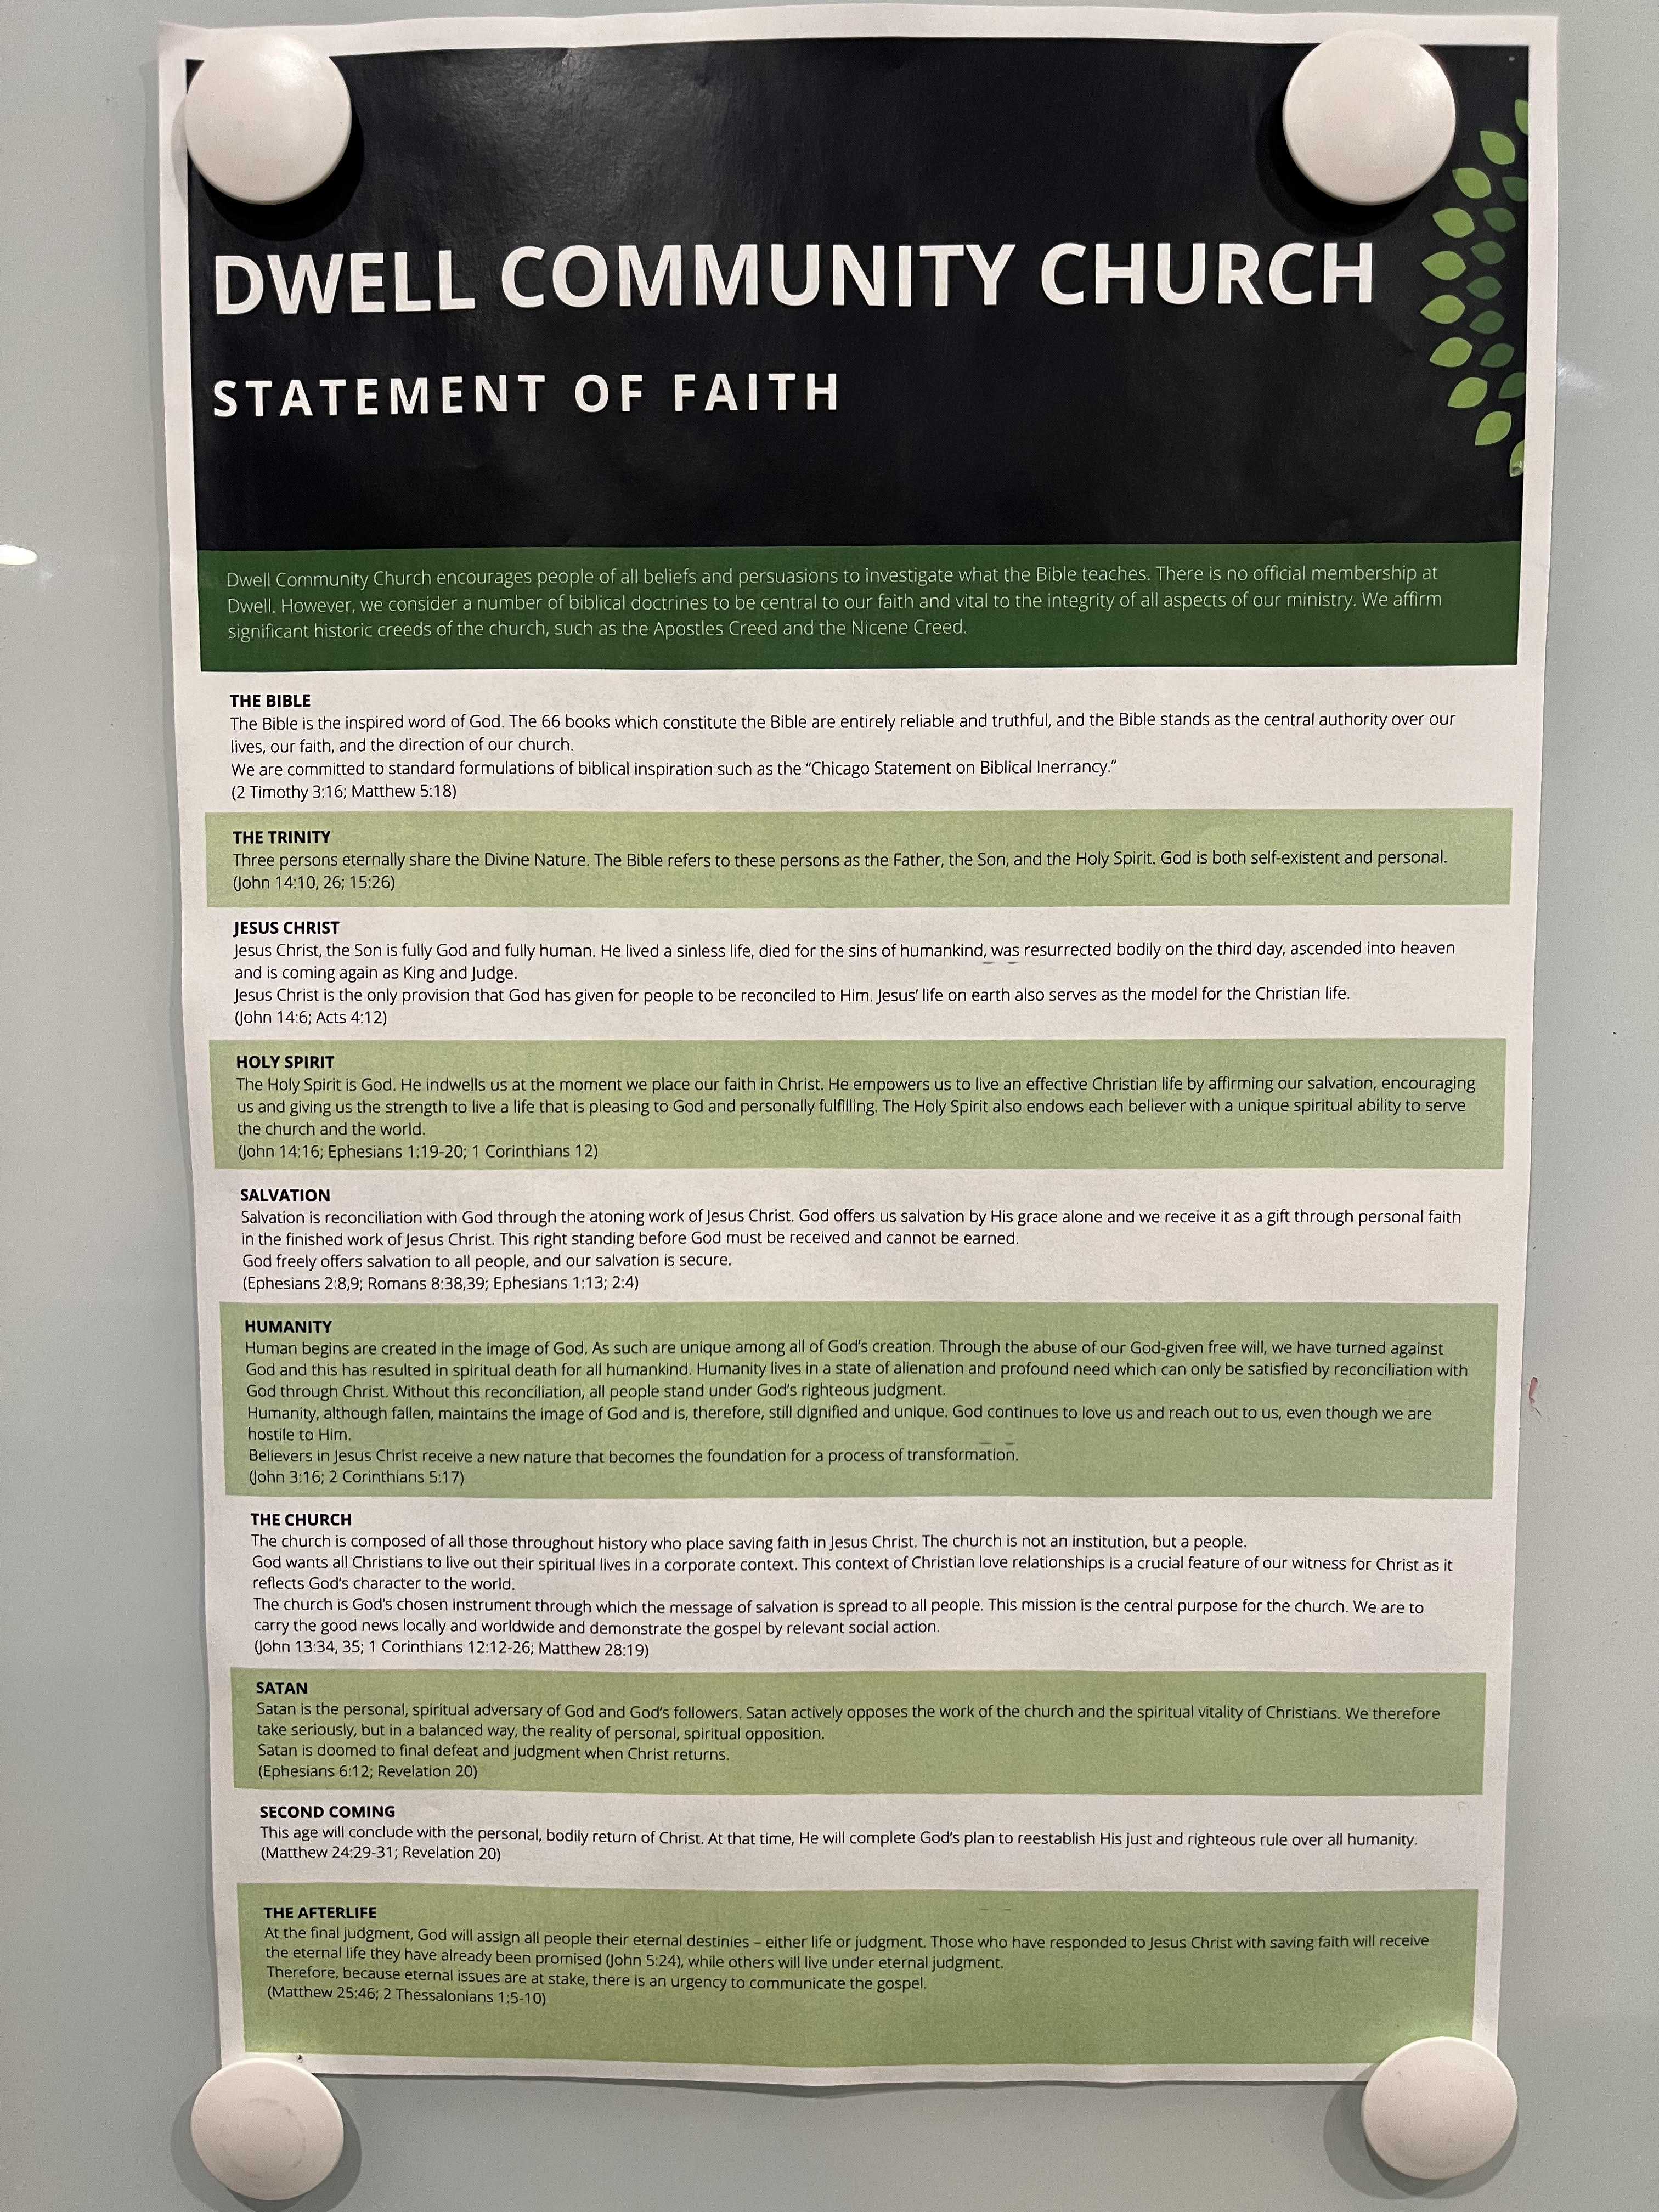
How Christian Unity Works
2) Relational, not Organizational
As a prisoner for the Lord, then, I urge you to live a life worthy of the calling you have received. ² Be completely humble and gentle; be patient, bearing with one another in love. ³ Make every effort to keep the unity of the Spirit through the bond of peace. ⁴ There is one body and one Spirit, just as you were called to one hope when you were called; ⁵ one Lord, one faith, one baptism; ⁶ one God and Father of all, who is over all and through all and in all.
⁷ But to each one of us grace has been given as Christ apportioned it.

Slide 14
How Christian Unity Works
2) Relational, not Organizational
As a prisoner for the Lord, then, I urge you to live a life worthy of the calling you have received. ² Be completely humble and gentle; be patient, bearing with one another in love. ³ Make every effort to keep the unity of the Spirit through the bond of peace. ⁴ There is one body and one Spirit, just as you were called to one hope when you were called; ⁵ one Lord, one faith, one baptism; ⁶ one God and Father of all, who is over all and through all and in all.
⁷ But to each one of us grace has been given as Christ apportioned it.
Heaven!
Organizational unity and relational unity?
Awful!
Neither organizational or relational unity?
Awful!
Organizational unity without relational unity?
Decent!
Relational unity with organizational variety?

Slide 15
How Christian Unity Works
2) Relational, not Organizational
Like Paul and Barnabas?
As a prisoner for the Lord, then, I urge you to live a life worthy of the calling you have received. ² Be completely humble and gentle; be patient, bearing with one another in love. ³ Make every effort to keep the unity of the Spirit through the bond of peace. ⁴ There is one body and one Spirit, just as you were called to one hope when you were called; ⁵ one Lord, one faith, one baptism; ⁶ one God and Father of all, who is over all and through all and in all.
⁷ But to each one of us grace has been given as Christ apportioned it.
Heaven!
Organizational unity and relational unity?
Awful!
Neither organizational or relational unity?
You might need to experience community with people who are wrong about some things.
Awful!
Organizational unity without relational unity?
Decent!
Relational unity with organizational variety?

Slide 16
How Christian Unity Works
3) Requires an others-centered attitude
As a prisoner for the Lord, then, I urge you to live a life worthy of the calling you have received. ² Be completely humble and gentle; be patient, bearing with one another in love. ³ Make every effort to keep the unity of the Spirit through the bond of peace. ⁴ There is one body and one Spirit, just as you were called to one hope when you were called; ⁵ one Lord, one faith, one baptism; ⁶ one God and Father of all, who is over all and through all and in all.
⁷ But to each one of us grace has been given as Christ apportioned it.
“God gives grace to the humble…. For he is faithful in the little things, and does not wait until he is given some great and outstanding thing to do. His is the meekness, the patient courage, which dares to… do the little and unnoticed things, which only a very few have the courage to wear themselves out in doing.“
-Under His Wings, Ole Halesby (p. 45)
Willingness to serve
“You must have the same attitude that Christ Jesus had. Though he was God….” [Phil. 2:5-6]

Slide 17
How Christian Unity Works
3) Requires an others-centered attitude
As a prisoner for the Lord, then, I urge you to live a life worthy of the calling you have received. ² Be completely humble and gentle; be patient, bearing with one another in love. ³ Make every effort to keep the unity of the Spirit through the bond of peace. ⁴ There is one body and one Spirit, just as you were called to one hope when you were called; ⁵ one Lord, one faith, one baptism; ⁶ one God and Father of all, who is over all and through all and in all.
⁷ But to each one of us grace has been given as Christ apportioned it.
Strength under control
A realistic view of our words
Chronic offenders: learn to be thoughtful

Slide 18
How Christian Unity Works
3) Requires an others-centered attitude
As a prisoner for the Lord, then, I urge you to live a life worthy of the calling you have received. ² Be completely humble and gentle; be patient, bearing with one another in love. ³ Make every effort to keep the unity of the Spirit through the bond of peace. ⁴ There is one body and one Spirit, just as you were called to one hope when you were called; ⁵ one Lord, one faith, one baptism; ⁶ one God and Father of all, who is over all and through all and in all.
⁷ But to each one of us grace has been given as Christ apportioned it.
Moving toward someone as they are now
Showing grace for imagined offenses… and borderline offenses… and legitimate offenses

Slide 19
How Christian Unity Works
3) Requires an others-centered attitude
As a prisoner for the Lord, then, I urge you to live a life worthy of the calling you have received. ² Be completely humble and gentle; be patient, bearing with one another in love. ³ Make every effort to keep the unity of the Spirit through the bond of peace. ⁴ There is one body and one Spirit, just as you were called to one hope when you were called; ⁵ one Lord, one faith, one baptism; ⁶ one God and Father of all, who is over all and through all and in all.
⁷ But to each one of us grace has been given as Christ apportioned it.
Moving toward someone as they are now
Showing grace for imagined offenses… and borderline offenses… and legitimate offenses

Slide 20
How Christian Unity Works
3) Requires an others-centered attitude
As a prisoner for the Lord, then, I urge you to live a life worthy of the calling you have received. ² Be completely humble and gentle; be patient, bearing with one another in love. ³ Make every effort to keep the unity of the Spirit through the bond of peace. ⁴ There is one body and one Spirit, just as you were called to one hope when you were called; ⁵ one Lord, one faith, one baptism; ⁶ one God and Father of all, who is over all and through all and in all.
⁷ But to each one of us grace has been given as Christ apportioned it.
What it takes to
get along with
people.
^these
^difficult
Moving toward someone as they are now
Showing grace for imagined offenses… and borderline offenses… and legitimate offenses
Chronic offendees: learn to be gracious

Slide 21
How Christian Unity Works
4) Requires Commitment & Hard Work
As a prisoner for the Lord, then, I urge you to live a life worthy of the calling you have received. ² Be completely humble and gentle; be patient, bearing with one another in love. ³ Make every effort to keep the unity of the Spirit through the bond of peace. ⁴ There is one body and one Spirit, just as you were called to one hope when you were called; ⁵ one Lord, one faith, one baptism; ⁶ one God and Father of all, who is over all and through all and in all.
⁷ But to each one of us grace has been given as Christ apportioned it.
Says they read that book you’re talking about but you KNOW they didn’t
Martyr complex
Judgmental
Lack of conflict = insufficient
:\
:\
Lack of conflict = maybe not a great sign?
Disunity can be active or passive
Talks to much
Doesn’t listen

Slide 22
How Christian Unity Works
4) Requires Commitment & Hard Work
:\
As a prisoner for the Lord, then, I urge you to live a life worthy of the calling you have received. ² Be completely humble and gentle; be patient, bearing with one another in love. ³ Make every effort to keep the unity of the Spirit through the bond of peace. ⁴ There is one body and one Spirit, just as you were called to one hope when you were called; ⁵ one Lord, one faith, one baptism; ⁶ one God and Father of all, who is over all and through all and in all.
⁷ But to each one of us grace has been given as Christ apportioned it.
Lack of conflict = insufficient
:\
Lack of conflict = maybe not a great sign?
Disunity can be active or passive

Slide 23
How Christian Unity Works
5) Expression of a spiritual reality
As a prisoner for the Lord, then, I urge you to live a life worthy of the calling you have received. ² Be completely humble and gentle; be patient, bearing with one another in love. ³ Make every effort to keep the unity of the Spirit through the bond of peace. ⁴ There is one body and one Spirit, just as you were called to one hope when you were called; ⁵ one Lord, one faith, one baptism; ⁶ one God and Father of all, who is over all and through all and in all.
⁷ But to each one of us grace has been given as Christ apportioned it.
“We, who are many, are one body in Christ, and individually parts of one another.” [Rom. 12:4]
Connected to Jesus = connected with others
Part of who I am now through Jesus (like forgiven, adopted, etc.)

Slide 24
How Christian Unity Works
5) Expression of a spiritual reality
Call to pursue unity based on Jesus first loving us
As a prisoner for the Lord, then, I urge you to live a life worthy of the calling you have received. ² Be completely humble and gentle; be patient, bearing with one another in love. ³ Make every effort to keep the unity of the Spirit through the bond of peace. ⁴ There is one body and one Spirit, just as you were called to one hope when you were called; ⁵ one Lord, one faith, one baptism; ⁶ one God and Father of all, who is over all and through all and in all.
⁷ But to each one of us grace has been given as Christ apportioned it.
The unity itself based on our REAL connection

Slide 25
How Christian Unity Works
5) Expression of a spiritual reality
Call to pursue unity based on Jesus first loving us
As a prisoner for the Lord, then, I urge you to live a life worthy of the calling you have received. ² Be completely humble and gentle; be patient, bearing with one another in love. ³ Make every effort to keep the unity of the Spirit through the bond of peace. ⁴ There is one body and one Spirit, just as you were called to one hope when you were called; ⁵ one Lord, one faith, one baptism; ⁶ one God and Father of all, who is over all and through all and in all.
⁷ But to each one of us grace has been given as Christ apportioned it.
The unity itself based on our REAL connection
Purposefully placed together by God “just as he desired”
Having God himself in common with each other
About the same message and purpose
Destined to be together forever

Slide 26
How Christian Unity Works
5) Expression of a spiritual reality
As a prisoner for the Lord, then, I urge you to live a life worthy of the calling you have received. ² Be completely humble and gentle; be patient, bearing with one another in love. ³ Make every effort to keep the unity of the Spirit through the bond of peace. ⁴ There is one body and one Spirit, just as you were called to one hope when you were called; ⁵ one Lord, one faith, one baptism; ⁶ one God and Father of all, who is over all and through all and in all.
⁷ But to each one of us grace has been given as Christ apportioned it.
Consider what could be in your relationships in the Body of Christ.
But focus on what already is.
Is this a good group?
Every Christian has an AMAZING degree of unity with any and every other Christian… so now live that out!

Slide 27
How Christian Unity Works
The Big Picture
In response to God’s unthinkable, astounding blessings through Christ
As a prisoner for the Lord, then, I urge you to live a life worthy of the calling you have received. ² Be completely humble and gentle; be patient, bearing with one another in love. ³ Make every effort to keep the unity of the Spirit through the bond of peace. ⁴ There is one body and one Spirit, just as you were called to one hope when you were called; ⁵ one Lord, one faith, one baptism; ⁶ one God and Father of all, who is over all and through all and in all.
⁷ But to each one of us grace has been given as Christ apportioned it.
Take an others’ centered attitude and a willingness to work
And live out a little of the incredible unity Jesus has already given us.

Slide 28
How Christian Unity Works
The Big Picture
In response to God’s unthinkable, astounding blessings through Christ
As a prisoner for the Lord, then, I urge you to live a life worthy of the calling you have received. ² Be completely humble and gentle; be patient, bearing with one another in love. ³ Make every effort to keep the unity of the Spirit through the bond of peace. ⁴ There is one body and one Spirit, just as you were called to one hope when you were called; ⁵ one Lord, one faith, one baptism; ⁶ one God and Father of all, who is over all and through all and in all.
⁷ But to each one of us grace has been given as Christ apportioned it.
Take an others’ centered attitude and a willingness to work
And live out a little of the incredible unity Jesus has already given us.
Next time…

Slide 29
Ephesians 4:1-6
UNITY: Taking Action
In response to God’s unthinkable, astounding blessings through Christ
Join the ekklesia (“called out ones”)
Get involved in a home group: ideal setting to experience these truths
Commit before God to responding to the Good News by diving in with people
With those people… the miracle it would take to unite you already happened
“My unity has started to slip. Time to get back at it.” ← Get used to this.
Take an others’ centered attitude and a willingness to work
And live out a little of the incredible unity Jesus has already given us.
They gave themselves first of all to the Lord, and then by the will of God also to us. [2 Cor. 8:5)

Slide 30
Ephesians 4:1-6
UNITY: Taking Action
In response to God’s unthinkable, astounding blessings through Christ
Join the ekklesia (“called out ones”)
Get involved in a home group: ideal setting to experience these truths
Commit before God to responding to the Good News by diving in with people
With those people… the miracle it would take to unite you already happened
“My unity has started to slip. Time to get back at it.” ← Get used to this.
Take an others’ centered attitude and a willingness to work
And live out a little of the incredible unity Jesus has already given us.

Slide 31
Ephesians 4:1-6 Unity: Discussion
Questions? Comments? Experiences?
dufaultb@dwellcc.org

