Slide 1
John 9
And Now I See!

Slide 2
Maybe you remember your early spiritual questions
These questions often get more profound (and painful) as we mature
One of the most common: Why does God allow suffering?

Slide 3
John 7:24 – “Stop judging by mere appearances, but instead judge correctly.”
John 8:12 – “I am the light of the world! Whoever follows me will never walk in darkness, but will have the light of life.”

Slide 4
John 20:30-31 - Jesus performed many other signs in the presence of his disciples, which are not recorded in this book.
But these are written that you may believe that Jesus is the Savior, the Son of God, and that by believing you may have life in his name.

Slide 5
John 9
1 As Jesus went along, he saw a man blind from birth.

Slide 6
John 9
1 As Jesus went along, he saw a man blind from birth.
2 His disciples asked him, “Rabbi, who sinned, this man or his parents, that he was born blind?”
Rabbis didn’t want to blame God for suffering, but that led to trying to determine whose fault it was.
That can lead to cruel conclusions

Slide 7
John 9
3 “Neither this man nor his parents sinned,” said Jesus,
“but this happened so that the works of God might be displayed in him.
This is true for any life, for any circumstance

Slide 8
John 9
3 “Neither this man nor his parents sinned,” said Jesus,
“but this happened so that the works of God might be displayed in him.
This is true for any life, for any circumstance
Big picture:
The question is not, “Will I suffer?” but
“How/When will I suffer?”
The follow-up: “Will my suffering mean anything?”
That’s the question only you can answer.

Slide 9
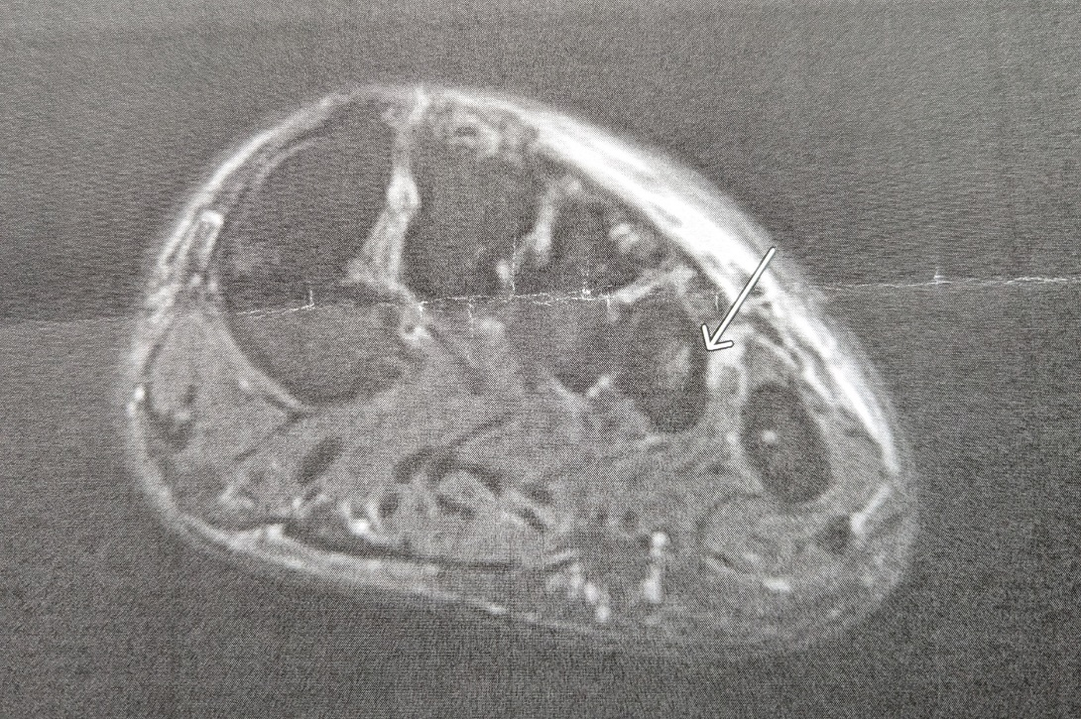
John 9
3 “Neither this man nor his parents sinned,” said Jesus,
“but this happened so that the works of God might be displayed in him.
This is true for any life, for any circumstance
Big picture:
The question is not, “Will I suffer?” but
“How/When will I suffer?”
The follow-up: “Will my suffering mean anything?”
That’s the question only you can answer.

Slide 10
John 9
3 “Neither this man nor his parents sinned,” said Jesus,
“but this happened so that the works of God might be displayed in him.
Lit “brought to light”

Slide 11
John 9
4 As long as it is day, we must do the works of him who sent me. Night is coming, when no one can work.
5 While I am in the world, I am the light of the world.”
John 1:4-5 – In him was life, and that life was the light of all mankind. The light shines in the darkness, and the darkness has not overcome it.
John 1:9 – The true light that gives light to everyone was coming into the world.

Slide 12
John 9
4 As long as it is day, we must do the works of him who sent me. Night is coming, when no one can work.
5 While I am in the world, I am the light of the world.”
This light is spiritual sight, which is infinitely more important than physical sight.
Ephesians 1:18 – “And I pray that the eyes of your heart may be enlightened”

Slide 13
John 9
4 As long as it is day, we must do the works of him who sent me. Night is coming, when no one can work.
5 While I am in the world, I am the light of the world.”

Slide 14
John 9
4 As long as it is day, we must do the works of him who sent me. Night is coming, when no one can work.
5 While I am in the world, I am the light of the world.”

Slide 15
John 9
6 After saying this, he spit on the ground, made some mud with the saliva, and put it on the man’s eyes.
7 “Go,” he told him, “wash in the Pool of Siloam” (this word means “Sent”).

Slide 16
John 9
6 After saying this, he spit on the ground, made some mud with the saliva, and put it on the man’s eyes.
7 “Go,” he told him, “wash in the Pool of Siloam” (this word means “Sent”).
What is the significance of the saliva and/or mud?
We have no idea
One thing that is clear: every miracle is unique – Jesus does not have a cookie-cutter approach.

Slide 17
John 9
6 After saying this, he spit on the ground, made some mud with the saliva, and put it on the man’s eyes.
7 “Go,” he told him, “wash in the Pool of Siloam” (this word means “Sent”).
Jesus, sent from God, sends the man to the pool named ‘Sent.’

Slide 18
John 9
So the man went
and washed,
and came home seeing.
Just like that.
Now what?

Slide 19
John 9
8 His neighbors and those who had formerly seen him begging asked, “Isn’t this the same man who used to sit and beg?” 9 Some claimed that he was.
Others said, “No, he only looks like him.”
They can’t believe their eyes!
Dismissal #1: “He only looks like him” – ‘The Doppelganger Effect’

Slide 20
John 9
8 His neighbors and those who had formerly seen him begging asked, “Isn’t this the same man who used to sit and beg?” 9 Some claimed that he was.
Others said, “No, he only looks like him.”
But he himself insisted, “I am the man.”
They can’t believe their eyes!
Dismissal #1: “He only looks like him” – ‘The Doppelganger Effect’

Slide 21
John 9
10 “How then were your eyes opened?” they asked.
11 He replied, “The man they call Jesus made some mud and put it on my eyes. He told me to go to Siloam and wash. So I went and washed, and then I could see.”

Slide 22
John 9
10 “How then were your eyes opened?” they asked.
11 He replied, “The man they call Jesus made some mud and put it on my eyes. He told me to go to Siloam and wash. So I went and washed, and then I could see.”
12 “Where is this man?” they asked him.
“I don’t know,” he said.

Slide 23
John 9
13 They brought to the Pharisees the man who had been blind.
14 Now the day on which Jesus had made the mud and opened the man’s eyes was a Sabbath.

Slide 24
The Sabbath
God told his people to work for 6 days, rest for 1
This was difficult to do for subsistence farmers
It was a conscious decision to trust God
Instead of focusing on rest, the Pharisees focused on, “What is work?”
Or, “What do we need to prohibit?”
39 total categories

Slide 25
1. Carrying
2. Burning
3. Extinguishing
4. Finishing
5. Writing
6. Erasing
7. Cooking
8. Washing
9. Sewing
10. Tearing
11. Knotting
12. Untying
13. Shaping
14. Plowing
15. Planting
16. Reaping
17. Harvesting
18. Threshing
19. Winnowing
20. Selecting
21. Sifting
22. Grinding
23. Kneading
24. Combing
25. Spinning
26. Dyeing
27. Chain-stitching
28. Warping
29. Weaving
30. Unraveling
31. Building
32. Demolishing
33. Trapping
34. Shearing
35. Slaughtering
36. Skinning
37. Tanning
38. Smoothing
39. Marking

Slide 26
John 9
13 They brought to the Pharisees the man who had been blind.
14 Now the day on which Jesus had made the mud and opened the man’s eyes was a Sabbath.
On the one hand, we all do this – we all add in rules to make ourselves feel better
On the other hand, Jesus had an especially strong critique for religious leaders who taught, “This is what God wants.”

Slide 27
John 9
13 They brought to the Pharisees the man who had been blind.
14 Now the day on which Jesus had made the mud and opened the man’s eyes was a Sabbath.
Jesus broke at least 3 rules:
No healing
No kneading (or maybe ‘no plowing’)
No anointing

Slide 28
John 9
15 Therefore the Pharisees also asked him how he had received his sight.
“He put mud on my eyes,” the man replied, “and I washed, and now I see.”

Slide 29
John 9
16 Some of the Pharisees said, “This man is not from God, for he does not keep the Sabbath.”
Jesus kept the true Sabbath, just not their extra rules

Slide 30
John 9
16 Some of the Pharisees said, “This man is not from God, for he does not keep the Sabbath.”
But others asked, “How can a sinner perform such signs?” So they were divided.
Two main schools:
School of Shammai (prohibited prayers for healing on the Sabbath)
School of Hillel (allowed prayers for healing on the Sabbath)

Slide 31
John 9
17 Then they turned again to the blind man, “What have you to say about him? It was your eyes he opened.”
The man replied, “He is a prophet.”

Slide 32
John 9
17 Then they turned again to the blind man, “What have you to say about him? It was your eyes he opened.”
The man replied, “He is a prophet.”
His understanding (spiritual sight) is growing

Slide 33
John 9
18 They still did not believe that he had been blind and had received his sight until they sent for the man’s parents.
19 “Is this your son?” they asked. “Is this the one you say was born blind? How is it that now he can see?”
Dismissal #2: “Was he really born blind?” – ‘The Pseudo-miracle’

Slide 34
John 9
22 His parents said this because they were afraid of the Jewish leaders, who already had decided that anyone who acknowledged that Jesus was the Messiah would be put out of the synagogue.
23 That was why his parents said, “He is of age; ask him.”
Not all families will be supportive of someone learning about Jesus

Slide 35
John 9
24 A second time they summoned the man who had been blind. “Give glory to God by telling the truth,” they said. “We know this man is a sinner.”
Dismissal #3: ‘You are lying.’

Slide 36
John 9
25 He replied, “Whether he is a sinner or not, I don’t know.
One thing I do know. I was blind but now I see!”
I was _____ but now I ______
I was lost but now I am found
I was alone but now I belong to God
I was depressed but now I have joy
I was damaged but now I have healing

Slide 37
John 9
26 Then they asked him, “What did he do to you? How did he open your eyes?”
27 He answered, “I have told you already and you did not listen. Why do you want to hear it again? Do you want to become his disciples too?”

Slide 38
John 9
28 Then they hurled insults at him and said, “You are this fellow’s disciple! We are disciples of Moses!
29 We know that God spoke to Moses, but as for this fellow, we don’t even know where he comes from.”
Dismissal #4: ‘You are untrained and unspiritual.’

Slide 39
John 9
30 The man answered, “Now that is remarkable! You don’t know where he comes from, yet he opened my eyes.
31 We know that God does not listen to sinners. He listens to the godly person who does his will.
32 Nobody has ever heard of opening the eyes of a man born blind.
33 If this man were not from God, he could do nothing.”

Slide 40
John 9
34 To this they replied, “You were steeped in sin at birth; how dare you lecture us!” And they threw him out.
Dismissal #5: ‘You are a sinner.’
Classic ‘ad hominem’ attack

Slide 41
John 9
34 To this they replied, “You were steeped in sin at birth; how dare you lecture us!” And they threw him out.
Dismissal #5: ‘You are a sinner.’
Classic ‘ad hominem’ attack
Also, Jesus told us he wasn’t blind because of sin
Further, the Pharisees are implying they weren’t steeped in sin at birth

Slide 42
John 9
35 Jesus heard that they had thrown him out, and when he found him, he said, “Do you believe in the Son of Man?”
Psalm 27:10 – Though my mother and father [or even my religious community] forsake me, yet the Lord will receive me.
This man labeled Jesus as, “the man called Jesus,” and “a prophet.” Now Jesus seeks him out to reveal Himself clearly.

Slide 43
John 9
35 Jesus heard that they had thrown him out, and when he found him, he said, “Do you believe in the Son of Man?”
Psalm 27:10 – Though my mother and father [or even my religious community] forsake me, yet the Lord will receive me.
This man labeled Jesus as, “the man called Jesus,” and “a prophet.” Now Jesus seeks him out to reveal Himself clearly.

Slide 44
John 9
35 Jesus heard that they had thrown him out, and when he found him, he said, “Do you believe in the Son of Man?”
Psalm 27:10 – Though my mother and father [or even my religious community] forsake me, yet the Lord will receive me.
This man labeled Jesus as, “the man called Jesus,” and “a prophet.” Now Jesus seeks him out to reveal Himself clearly.

Slide 45
John 9
36 “Who is he, sir?” the man asked. “Tell me so that I may believe in him.”
37 Jesus said, “You have now seen him; in fact, he is the one speaking with you.”
38 Then the man said, “Lord, I believe,” and he worshiped him.

Slide 46
John 9
39 Jesus said, “For judgment I have come into this world, so that the blind will see and those who see will become blind.”
40 Some Pharisees who were with him heard him say this and asked, “What? Are we blind too?”
41 Jesus said, “If you were blind, you would not be guilty of sin; but now that you claim you can see, your guilt remains.”
Proverbs 26:12 – Do you see a person wise in their own eyes? There is more hope for a fool than for them.

Slide 47
John 9
3 “Neither this man nor his parents sinned,” said Jesus,
“but this happened so that the works of God might be displayed in him.
This is true for any life, for any circumstance

Slide 48
Lessons from John 9
Do you believe in the Son of Man? We are all born blind; will you let Jesus reveal himself to you?
9:3 – “this happened so that the works of God might be displayed in him” – will you let God change your life for everyone to see?
“One thing I know” – will you testify to God’s healing power?

Slide 49
John 9
Questions?
Comments?
Experiences?
risleyc@dwellcc.com

